Slide 1

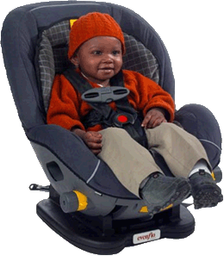
Buckle Up Challenges and Strategies for
Hard-To-Reach Groups

Slide 2



Moderator
Susanne Ogaitis-Jones, MSPH, CHES, CPST
Coordinator, CPS & OP Healthcare Project
Maryland Institute for
Emergency Medical Services Systems
This webinar is brought to you by the Maryland Institute for
Emergency Medical Services Systems EMSC Program, with funding from the Maryland Highway Safety Office and Federal traffic safety funds.

Slide 3
Housekeeping Details
Please put your phones on MUTE in order to minimize background noise, as the presentation is being recorded so that we can archive the slides and audio on our website.
Please save questions/comments until the end of the presentation.
At the end of the participation, we would be grateful if you would complete and send back a brief evaluation form.

Slide 4
Today’s Speakers
Jewel Johnson, CPST/I, Safety Advocate
Danitza A. Simpson, Director,
Adelphi-Langley Park Family Support Center
Moderator: Susanne Ogaitis-Jones, MSPH,
CPST, Coordinator of CPS, MIEMSS

Slide 5
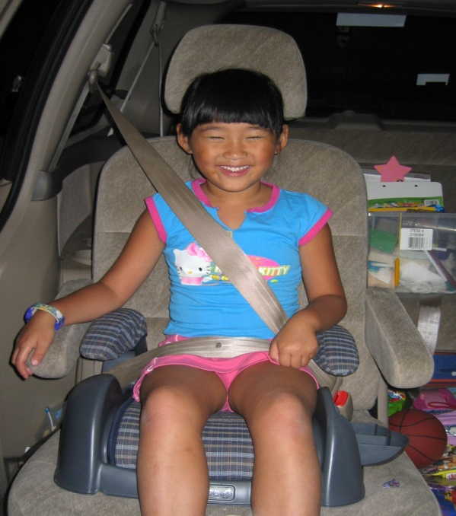
National Restraint Use Rates
National Survey of Use of Booster Seats, National Center for Statistics, NHTSA, 2008
Ages | All | Afr-Amer | Hispanic | Asian/n-H
1 – 3 yrs | 92 % | 74 % | 84 % | 99 %
4 – 7 yrs | 89 % | 84 % | 82 % | 95 %
8 – 12 yrs | 85 % | 72 % | 79% | 91 %
Observational survey of 14,000 occupants (7,500 children)

Slide 6
Maryland Restraint Use Rates
Seat Belt Use rate in 2010: 94.2 %
Child Safety Seat Use Rate: approx. 88.3%**
2010, among children ages 0–9 yrs involved in MVC. National Study Center
Maryland CSS Misuse rate: 74%
Use Rates By Sub-Populations ??

Slide 7
Challenges to Buckling Up
A study of 2002-2006 data from the National Trauma Database on car crashes involving children <16 years showed that less than half of the kids who had injuries were restrained, with the lowest restraint rates among African Americans, Hispanics, and Native Americans.
“Race/ethnicity did not affect mortality or length of hospital stay, but the use of restraints was associated with a lower injury severity score.” (Stark 2011)

Slide 8
Challenges to Buckling Up
“Child safety seat use is lower among rural populations and low income families.”
NHTSA, ‘Rural & Urban Crashes Comparative Analysis’ 1996.

Slide 9
Restraint Use in Population Groups: Hispanics
Seat belt use rates among adult Hispanic groups varies widely in studies, showing lower, comparable, and higher use compared to
non-Hispanic groups.
Injury Prevention, Dec 2006, 12(6), 421-426.

Slide 10
Restraint Use in Population Groups: Hispanics
“Hispanicity includes 20 Spanish-speaking nationalities that differ across many dimensions including immigration history, legal status, socioeconomic status, shades of skin color and political views. Therefore, cultural and behavioral differences between Hispanics of different national origins might affect prevalence of seat belt use.”
Injury Prevention, Dec 2006, 12(6), 421-426.

Slide 11
Challenges to Buckling Up
What are the challenges and strategies among specific sub-groups in getting adults and children buckled up—every time, in every vehicle, and having the restraints used properly?

Slide 12
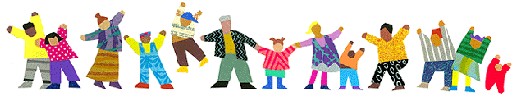
Bucking Up Challenges and Strategies in Hard-to-Reach Populations
Jewel Johnson, Traffic Safety Advocate

Slide 13
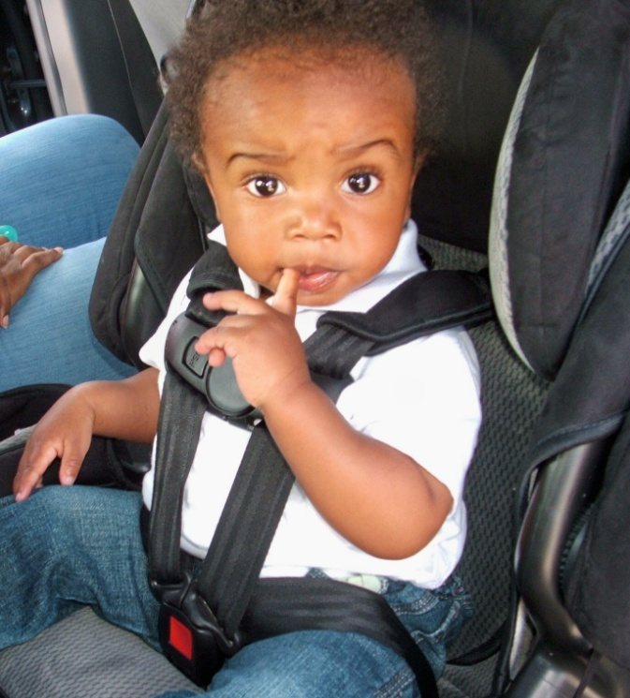
Challenges
Gaining trust
Bilingual literature and educational materials
Families migrate
Funding

Slide 14
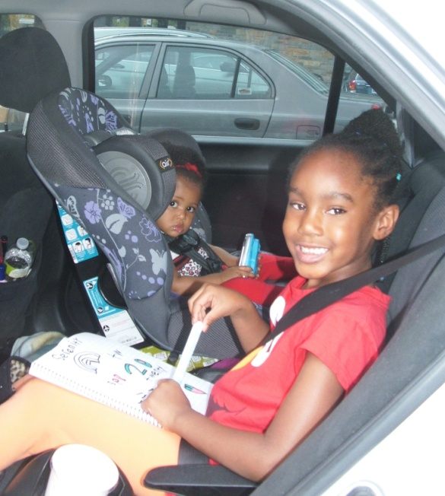
Give Kids A Boost
Baltimore’s Give Kids A Boost program is designed to link ongoing local childhood immunization efforts with an initiative to increase usage of car booster seats.

Slide 15
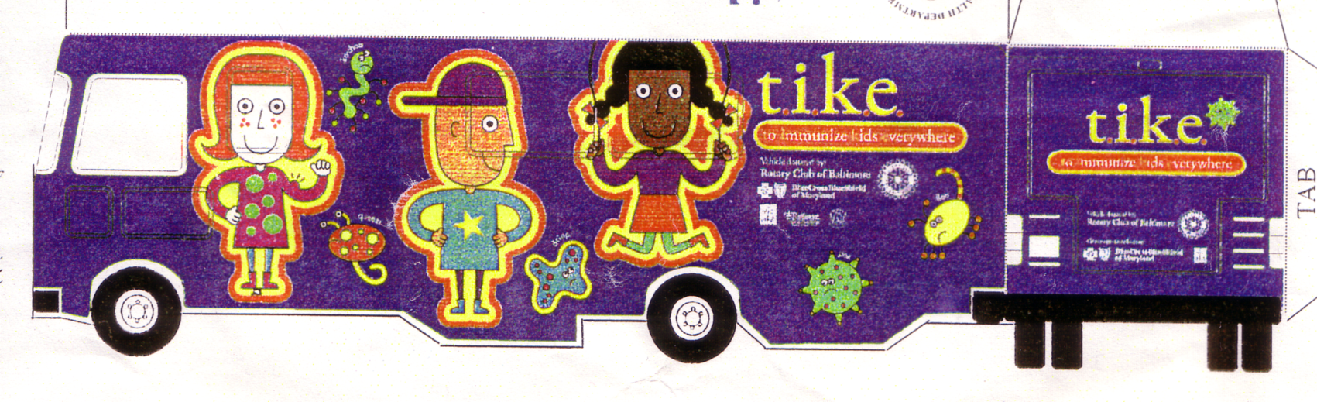
Give Kids A Boost!

Slide 16
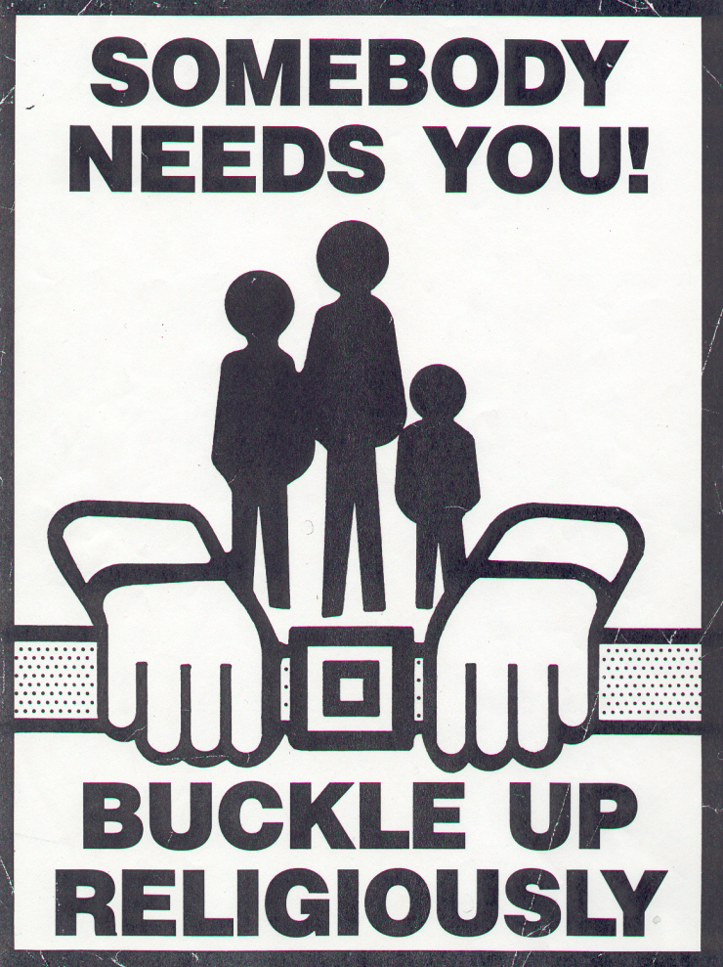
Buckle Up Religiously

Slide 17
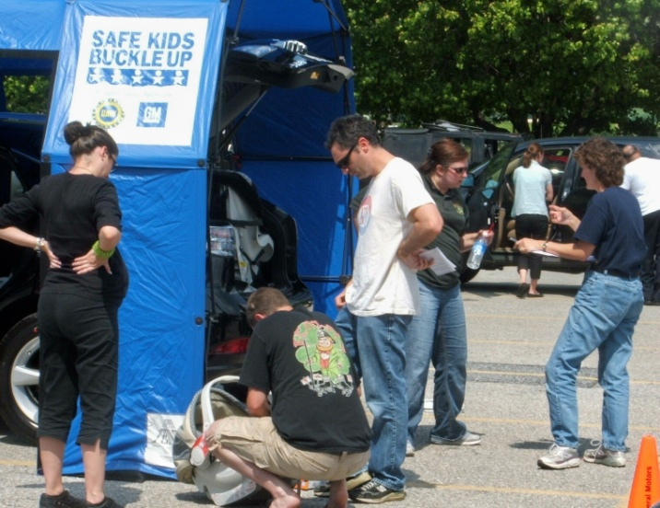
Safe Kids Baltimore’s Community Based Child Safety Seat Inspections
Monthly Baltimore City Fire Department. Urban and county residents.
Annually: Mt. Washington Pediatric Hospital, Giant Food Stores, Churches, and Head Start Centers.

Slide 18
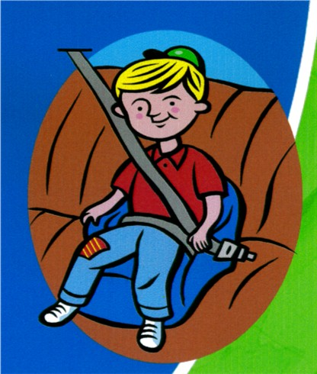

Walking and Riding Safely
Train-the-Trainer

Slide 19
Community Outreach Ideas
  Church Festivals
  Brush, Floss, and Buckle-Up
  Barber Shops
  Hair Salons
  Malls

Slide 20
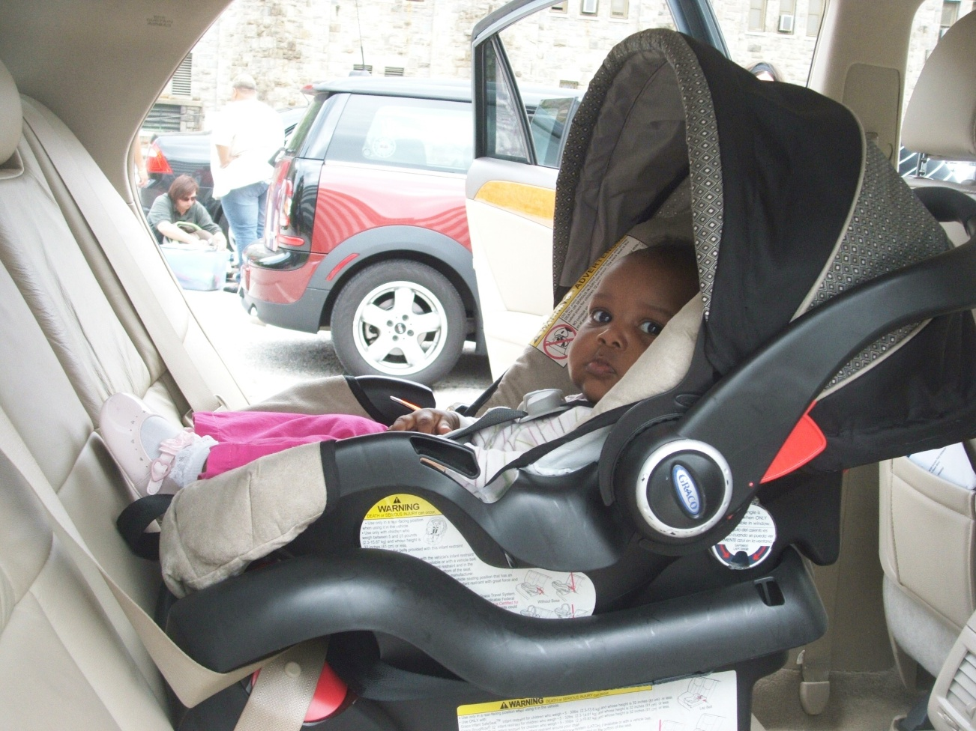
THANKS SO MUCH!

Slide 21
Buckling Up Challenges and Strategies In Hard-to-Reach Groups
Danitza A. Simpson

Slide 22
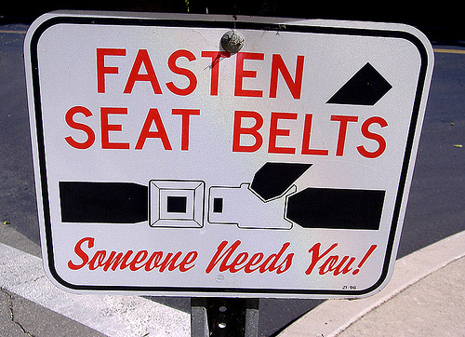
Seat Belt Use for Children

Slide 23
Low Use Rates of Seat Belt
Minorities
Low income families
Immigrants

Slide 24
Injuries and Death
Specific Reasons
In Latin American = the use of seat belts are not mandatory. When a woman delivers her child she can leave the hospital in a taxi, public transportation, and even in private vehicle without using a car seat or putting on her seat belt.
Safety seats are sold in the country, but not required to be used.

Slide 25
Injuries and Death
Specific Reasons
Seat belts are installed in every vehicle sold in Latin America, but not required to use them.
Some use seat belts because they practice safety and others because have been told by a relative or friend that in other countries it is a requirement.

Slide 26
Latin America
In Latin America owning a car is considered a luxury that many can’t afford.
Public transportation is more affordable and does not require the use of seat belts.

Slide 27
What Can Be Done
Educate the subgroups
Promote public announcements in their native language

Slide 28
What Can Be Done
Collaborate with community leaders to promote safety
    Faith-based
    Local non-profits
    Word of mouth
    Local schools
    Doctor’s office
    Community centers
    Community events
    Health fairs
    County agencies

Slide 29
What Can Be Done
Distribute literature along with someone who speaks their language to provide interpretation/translation helps
Fund community organizations to distribute car seats at low or no cost to residents and seat usage.
Educate the subgroups of stages of car seats and why it is important to properly place the child in them.

Slide 30
Assistance
Because our center is located in a needy population/area of the county, we are forced to apply for grants to sustain our Car Seat Loaner Program.
Many of the residents of the county are low-income or have no education beyond 6th grade.

Slide 31
Assistance
We are also seeing a rise in Guatemalan Natives who don’t speak Spanish or English. In order to communicate we use pictures, sign language, and other relatives.
Many of the families don’t see the need for car seats or putting on a seat belt and are forced to get one when being discharged from the hospital or are fined when pulled over by police.

Slide 32
Assistance
Some borrow from a relative or neighbor and others are referred to us.
These families run the risk of using an expired car seat or use it improperly.
Have on-hands demonstration or videos for those who can’t read or write.
Make literature/materials easy and brief

Slide 33
But most important
educate, educate, educate.
Thank you!

Slide 34
Challenges to Buckling Up
Kids aren’t buckled up because their parents or guardians aren’t buckled.

Slide 35
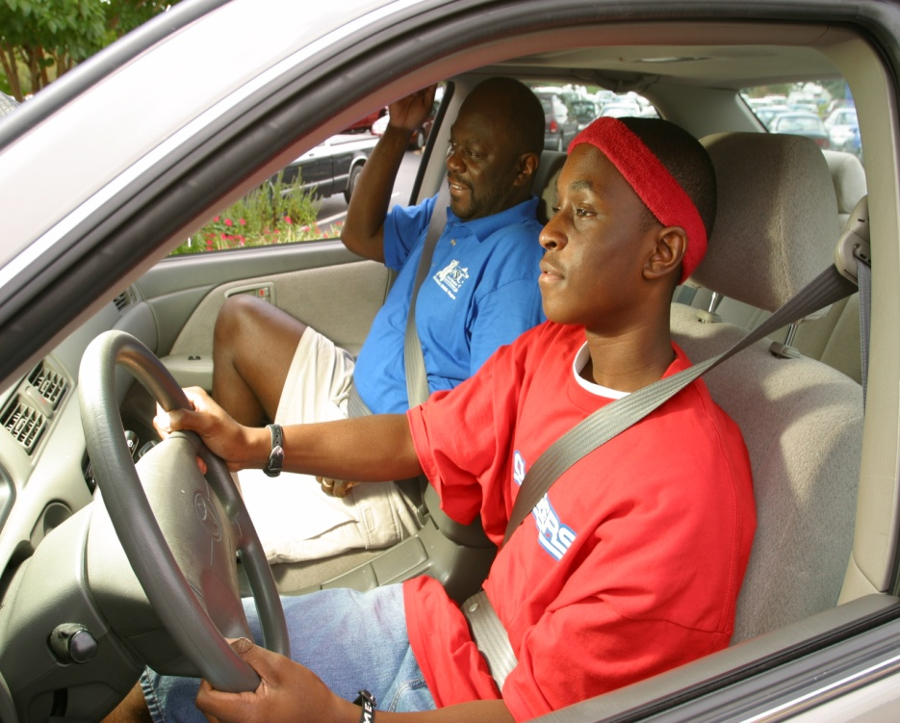
A driver who is buckled up is three times more likely to restrain a child passenger than one who is not buckled.
Journal Pediatrics, Vol. 102, No. 3, September 1998

Slide 36
Strategies for Buckling Up
Make buckling up a primary enforcement law
2007 study showed safety belt use was higher in states with primary versus secondary enforcement laws, both for overall population numbers and also for each socio-demographic characteristic examined:
safety belt use of 85% in states with primary laws
safety belt use of 74% in states with secondary laws
A 1999 national survey conducted by a leading African American researcher found that African Americans who live in primary enforcement states overwhelmingly supported a primary seat belt law by 3 to 1. Furthermore, 83% reported they always wear their safety belts, as opposed to only 66% of the African Americans in secondary enforcement states.
(Air Bag & Seat Belt Safety Campaign)

Slide 37
In a 2006 study of fatal crashes, seat belt use among Mexican-Americans and Central/South Americans in states with primary seat belt laws was more than 20% higher than among Hispanics in states with secondary laws.

Slide 38
Strategies for Buckling Up
    “Enact standard enforcement
    safety belt laws (primary laws)
    coupled with a zero tolerance provision for differential enforcement, particularly based on race.”
Formal recommendation by Meharry Medical College, a historically black college, 1998:

Slide 39
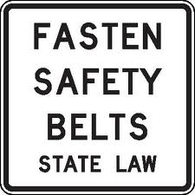
Strategies for Buckling Up
“Primary enforcement laws may have the greatest effect on sociodemographic groups that reported lower levels of safety belt use.”
Am J Public Health, 2007, Sept 97(9)

Slide 40
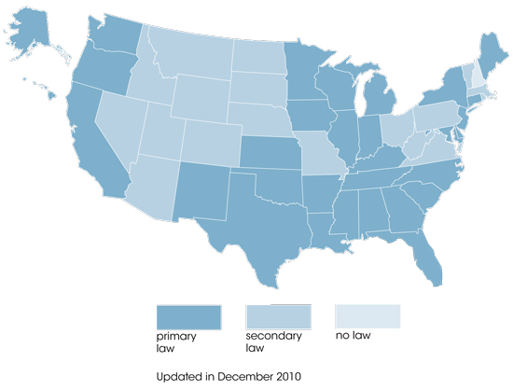
Safety Belt Enforcement
(Primary vs. Secondary vs. None) Dec 2010

Slide 41
Strategies for Buckling Up
Improve access to child safety seats
“When low income families do own a car seat, 95% of families use it, suggesting strategies to increase availability of free or low cost child safety seats might be effective.”
Children’s Safety Network; and Robitaille et. Al, 1990, Am J Pub Health

Slide 42
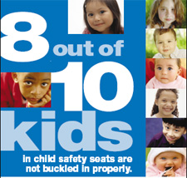
Challenges to Buckling Up
Proper use of child safety seats and seat belts…

Slide 43
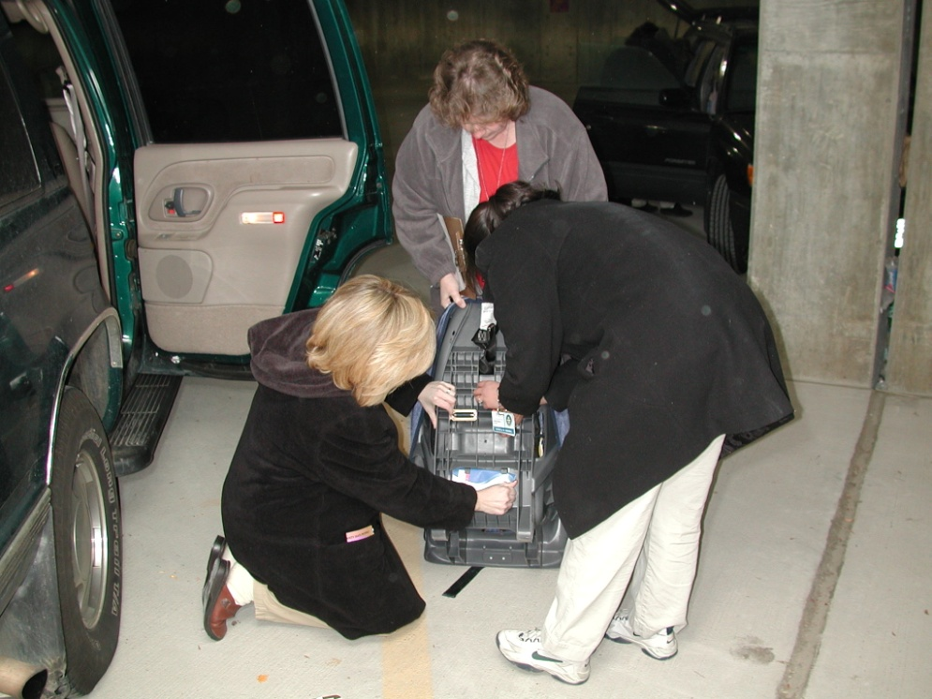
Safety Seat Checks
Prenatal and Parenting Classes
Hospital Wellness Services

Slide 44
Challenges to Buckling Up
Written language barriers
“Some of the informational sheets are very wordy and detailed, and some of our parents don’t even read in their own language.”
From NICU nurse in a DC-area hospital, May 2012
2003 study found most car safety seat manuals were written at a 10th grade level, while nearly a quarter of U.S. adults read at or below a 5th grade level and at least 25% read at about an 8th grade level.
Wegner & Girasek. Child, Youth & Envts 23(1), Spring 2003

Slide 45
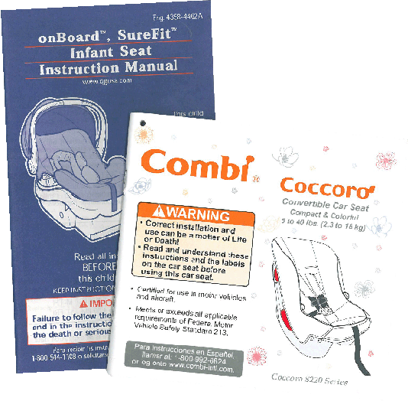

Slide 46
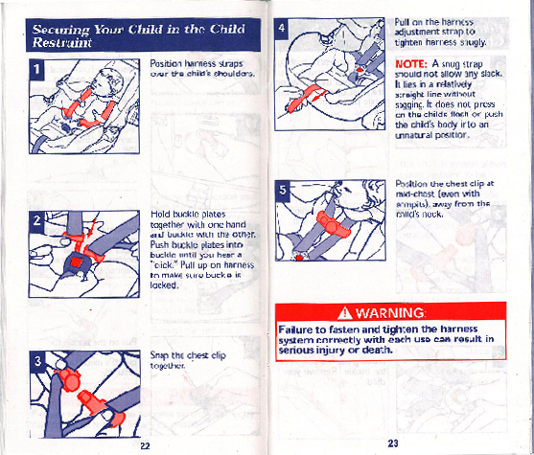
More graphics
Color coding
Simple words
Obvious warnings
Table of contents
Cultural competency/sensitivity

Slide 47
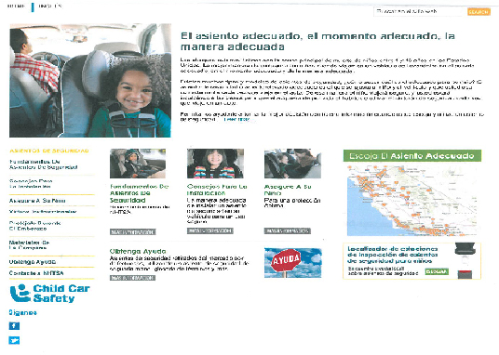

NHTSA: www.safercar.gov/protegidos
Strategies for Buckling Up

Slide 48
Non-English Language Resources Available from SafetyBeltSafe U.S.A.
Strategies for Buckling Up
Basic brochure (various languages) “Keep Your Children Safe” (low reading level; California and national versions available)
Armenian (#119) Cambodian (#150) Chinese (#94) Farsi (#183) Korean (#96) Russian (#33) Spanish (#29) Tagalog (#97) Vietnamese (#121)
Many educational pages available in Spanish
SafetyBeltSafe U.S.A.
P.O. Box 553, Altadena, CA 91003 www.carseat.org
310/222-6860, 800/745-SAFE (English),
310/222-6862, 800/747-SANO (Spanish)

Slide 49
Materials Available in Spanish
Through MIEMSS’ CPS Program:
Strategies for Buckling Up
Posters
Did you Receive a Prescription for Your Child’s Safety?
You Score When you Buckle Everyone Every Day!
Don’t Let It Slide…Always Buckle Right!
Handouts
Child Passenger Safety: Kids Can Live With It! (Safe Kids)
Maryland Child Passenger Safety Laws
Rx for your child’s safety/Boosters are for big kids
Contact: cps@miemss.org or 410-706-8647

Slide 50
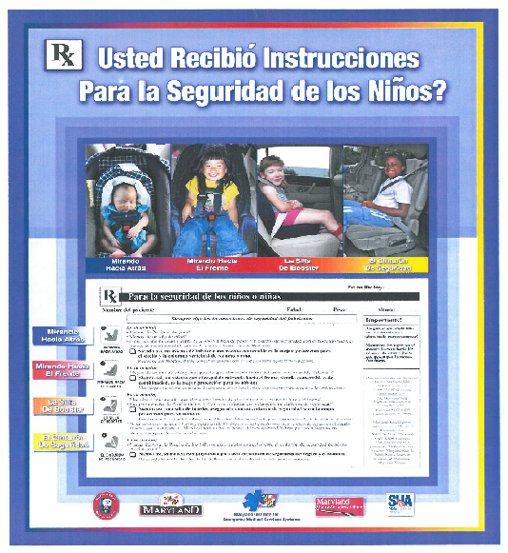

Slide 51
Other challenges or strategies with hard-to-reach groups?
Participants, please use your phone at this time to offer comments or ask questions that might assist all of us. Be sure to
un-mute your phone and speak up!

Slide 52
Thank you for participating today!
Final Instructions:
An evaluation form is available on our website: http://www.miemss.org/EMSCwww/CPSHome.htm; alternatively, we can email it to call participants.
Return your completed evaluation along with the contact info page.
The full presentation with audio will be available on our website in a couple of weeks, in case you wish to re-visit it, or refer a colleague to it.

