Slide 1

Housekeeping Details
Safe Transport of Children in Ambulances
Webinar: March 28, 2013
Please put your phones on MUTE in order to minimize background noise, as the presentation is being recorded so that we can archive the slides & audio on our website.
Please save questions/comments until the end of the presentation.
Complete and mail back the evaluation form and the participant information form.

Slide 2


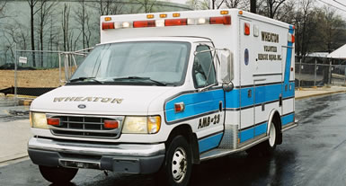
Safe Transport of Children in Ambulances
EMSC Partnership Grant from HRSA/MCHB
CPS & OP Highway Safety Grant from Maryland Highway Safety Office/NHTSA

Slide 3
Objectives
Describe the distinct features of ambulances that place children, families & providers at risk.
Review NHTSA September 2012 Recommendations
Identify different restraint devices available for use on ambulances – stretchers and other seating positions
Discuss appropriate restraint devices based upon weight and height
Recognize key techniques in securing devices to stretchers of different types
Identify appropriate (and inappropriate) seating positions for children in ambulances

Slide 4
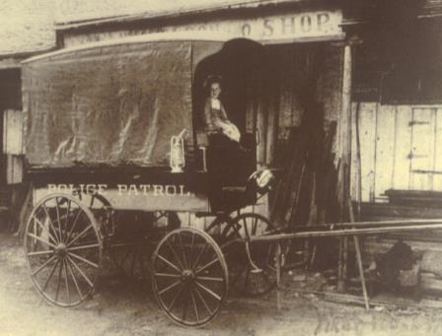
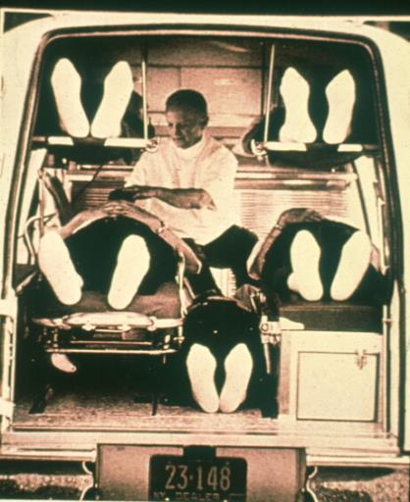
Evolution of EMS Transport
Late 1800’s
New York City & Cincinnati
A function of police and fire

Slide 5
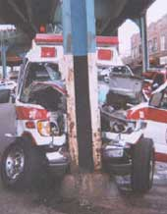
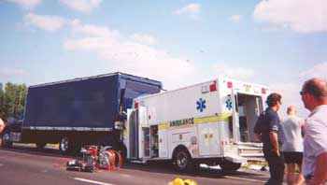
Maryland Automated “Accident” Reporting System (MAARS)
In Maryland, there is a crash involving an ambulance at least once a day – fender benders to fatalities.

Slide 6
National Institute for Occupational Safety and Health (NIOSH)- Division of Safety Research
RECOMMENDATIONS based upon data & crash reconstruction currently available:
Ensure that emergency service workers use the patient compartment vehicle occupant restraints whenever possible
Ensure that patient cots are equipped with upper body safety restraints for use during emergency & non-emergency transports
Ensure that drivers and front-seat passengers of emergency service vehicles use the vehicle occupant restraints that are provided.
Evaluate and develop occupant protection systems designed to increase the crash survivability of EMS workers in ambulance patient compartments while still providing the necessary mobility to provide patient care during transport.

Slide 7
Basics of Ambulance Transport
SECURE messaging
    Stretcher with 3 safety straps &
    2 over shoulder harness
    Equipment is secured with straps in working order
    Cabinets are closed & latched / locked
    Use age & size appropriate restraints for patients
Oxygen is Restrained in crash stable brackets
    Everyone is secured in a restraint - patient, providers & family

Slide 8
Safe Transport of Children
Recommendations for the Safe Transportation of Children in Emergency Ground Ambulances
  NHTSA’s Office of EMS and the Occupant Protection Division are continuing to work with other Federal and organizational partners on this effort
Two year process lead by NHTSA Office of Occupant Protection and Office of EMS to review literature, research and make recommendations
Working Group made up of variety of EMS and Child Passenger Safety organizations representing both private and fire based systems
Notes:
8

Slide 9











Project Work Group
Work Group Representative Organizations
American Ambulance Association
The American Academy of Pediatrics
American College of Emergency Physicians
International Association of Fire Chiefs
National Association of Emergency Medical Service Physicians
National Association of Emergency Medical Technicians
National Association of State EMS Officials
National Volunteer Fire Council
National Emergency Medical Services for Children Resource Center
Emergency Nurses Association
International Association of Fire Fighters
Notes:
9
9

Slide 10
Safe Transport of Children
Timeline: Spring 2009 to September 2012
  Conference calls Spring 2009 and July 2009 in person meeting lead to draft recommendations posted on web for public comments in September 2009
  Public review meeting and webinar offered mid-summer 2010
  Final recommendations were due to NHTSA from Maryn Consulting by late 2010 with public hearing held at NHTSA August 2010
  Final product released on the NHTSA EMS Website in September 2012
  NC, NY, IA and MD are currently building educational programs
Notes:
10

Slide 11

Project Background and Objectives
Questions within the Emergency Medical Services Community
 | How best to transport children in ambulances from the scene of a traffic crash to a hospital or other facility.
 | How or if to use a child safety seat on a stretcher.
 | How to properly secure EMS equipment.
 | What are the protocols for placement and restraint of injured, ill, or uninjured children in emergency response vehicles?
Resulting Issues from these Questions
 | The absence of consistent standards and protocols complicates the work of EMS professionals.
 | This may result in the improper restraint of highly vulnerable child passengers.
 | EMS agencies, advocates and academicians have turned to NHTSA to resolve this issue.
Notes:
11

Slide 12
Project Background and Objectives
Objective 1:
Begin the process of building consensus in the development of a uniform set of recommendations to safely and appropriately transport children (injured, ill, or uninjured) from the scene of a crash or other incident in an ambulance.
Objective 2:
To foster the creation of draft best practice recommendations after reviewing the practices that are currently being used to transport children in ambulances.
Objective 3:
To provide consistent national recommendations that will be embraced by local, state and national EMS organizations, enabling them to reduce the frequency of inappropriate emergency transport of ill, injured or uninjured children.
Notes:
12

Slide 13

This Project Was Not Designed To:
Evaluate the efficacy of one restraint over another
Conduct any field tests of solutions or equipment
Evaluate the crashworthiness of emergency vehicles
Assess ambulance design
Identify recommendations for inter-facility transfer practices
Explore vehicles other than ambulances
Notes:
13

Slide 14
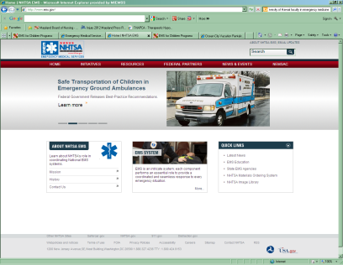
The Document Contains:
Glossary of terms
Background of project
Working group members
Description of the problem
Previous guidance regarding the transporting children safely in ground ambulances
Non-technical definition of a child
Note regarding operational safety issues related to transporting children safely in ground ambulances
www.ems.gov

Slide 15
First Principle: Make Everything as a Safe as Possible…
General Operational Policy and Procedures
Seat belt and restraint use for ALL ambulance occupants all of the time;
Secure all movable equipment;
Driver screening and selection (including background checks as provided for by the State’s EMS personnel policy);
Monitoring of driving practices through use of technology and other means;
Use of principles of emergency medical dispatching to determine resource and response modalities; and
Methods to reduce the unnecessary use of emergency lights and sirens (when transporting patients) when appropriate.

Slide 16
First Principle: Make Everything as a Safe as Possible…
General Operational Policy and Procedures (Cont.)
Maintaining and cleaning neonatal and child restraint seats and equipment per manufacturer’s instructions;
Following current pediatric standards of care for injured children;
Training that includes hands-on emergency ground ambulance operation instruction;

Slide 17
Five Situations were Identified as Most Frequently Faced by EMS Providers & Interfacility Transport Teams
Recommendations:
  For a child who is uninjured/not ill
  For a child who is ill and/or injured and whose condition does not require continuous and/or intensive medical monitoring and/or interventions
  For a child whose condition requires continuous and/or intensive medical monitoring and/or interventions
  For a child whose condition requires spinal immobilization and/or lying flat
  For a child or children who require transport as part of a multiple patient transport (newborn with mother, multiple children, etc.)

Slide 18
Recommendations Include:
Recommendation that every EMS agency preplan for these situations based upon local and regional resources
“The Ideal” and when the ideal is not practical or achievable
Limitations of the recommendations
Additional recommendations beyond the scope of the project
  Recommendations for Governmental and other entities to consider
  Recommendations for manufacturers to consider
In the appendix:
  Executive Summary
  Equipment to support recommendations

Slide 19

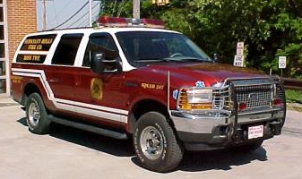
  Recommendation #1 –
For a child who is uninjured/not ill
The Ideal
  Transport the child in a vehicle other than an emergency ground ambulance using a size-appropriate child restraint system that complies with FMVSS No. 213.
  Consult child restraint manufacturer’s guidelines to determine optimal orientation for the child restraint (i.e., rear-facing or forward-facing) depending on the age and size of the child.
NOTE: do not place children in a police car with a prisoner screen present

Slide 20
If the Ideal is not Practical or Achievable…
Transport the child in a size-appropriate child restraint system that complies with FMVSS No. 213 appropriately installed in the front passenger seat (with air bags in the “off” position, if an on/off switch is available) of the emergency ground ambulance; OR
Transport the child in the forward-facing EMS provider’s seat /captain’s chair, (which is currently rare in the industry) in a size-appropriate child restraint system that complies with FMVSS No. 213; OR
Transport the child in the rear-facing EMS provider’s seat/captain’s chair in a size-appropriate child restraint system that complies with FMVSS No. 213. This system can be a convertible or combination seat using a forward-facing belt path. Do not use a rear-facing only seat in the rear-facing EMS provider’s seat. You may also use an integrated child restraint system certified by the manufacturer to meet the injury criteria of FMVSS No. 213; OR
If necessary, transport the ill or injured patient in the original emergency ground ambulance and leave the non-ill, non-injured child under appropriate adult supervision on scene. Transport the non-ill, non-injured child in a size-appropriate child restraint system that complies with FMVSS No. 213 to a hospital, residence or other location, in another appropriate vehicle.

Slide 21
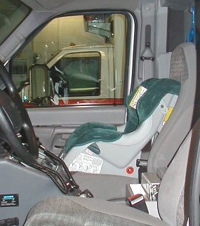
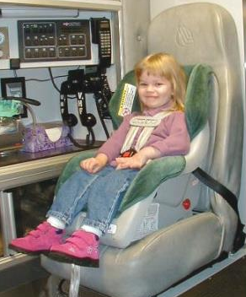
What Does that Look Like?

Slide 22
  Recommendation #2
For a child who is ill and/or injured and whose condition does not require continuous and/or intensive medical monitoring and/or interventions
The Ideal
  Transport the child in a size-appropriate child restraint system that complies with the injury criteria of FMVSS No. 213—secured appropriately on cot.

Slide 23
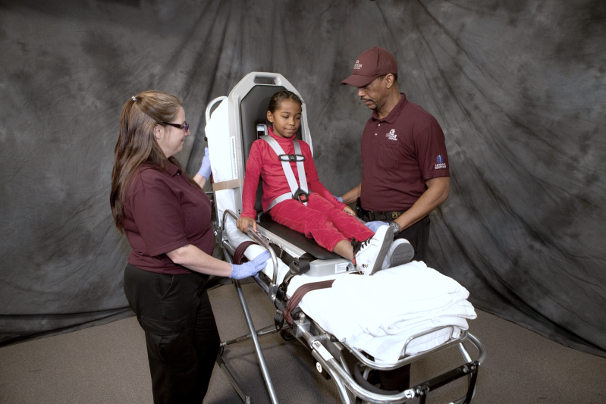
What Does that Look Like?

Slide 24
If the Ideal is not Practical or Achievable…
Transport in the forward-facing EMS provider’s seat/ captain’s chair (which is currently rare in the industry) in a size-appropriate child restraint system that complies with FMVSS No. 213. Consult child restraint manufacturers’ guidelines to determine optimal orientation for the child restraint (i.e., rear-facing or forward-facing), depending on the age and size of the child.
Transport the child in the rear-facing EMS provider’s seat/ captain’s chair in a size-appropriate child restraint system that complies with FMVSS No. 213. This system can be a convertible or combination seat using a forward- facing belt path. Do not use a rear-facing-only seat in the rear-facing EMS provider’s seat. You may also use an integrated child restraint system certified by the manufacturer to meet the injury criteria of FMVSS No. 213; OR
Secure the child to the cot, head first, using three horizontal restraints across the child’s torso (chest, waist, and knees) and one vertical restraint across each of the child’s shoulders. The cot should be positioned (subject to the manufacturer’s specifications) to provide for the child’s comfort based upon the child’s injuries and/or illness and to allow for appropriate medical care.

Slide 25
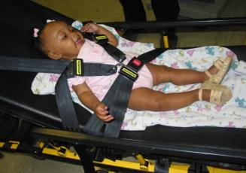
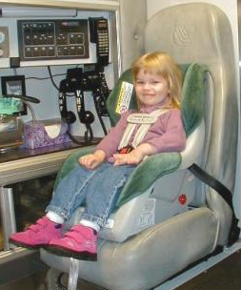
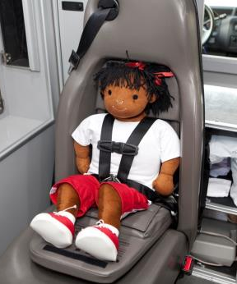
What Does that Look Like?

Slide 26
  Recommendation #3
  For a child whose condition requires continuous and/or intensive medical monitoring and/or interventions
The Ideal
  Transport the child in a size-appropriate child restraint system that complies with the injury criteria of FMVSS No. 213—secured appropriately on cot.

Slide 27
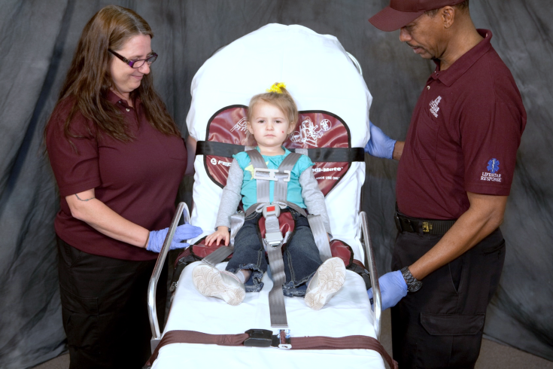
What Does that Look Like?

Slide 28
If the Ideal is not Practical or Achievable…
Secure the child to the cot; head first, with three horizontal restraints across the torso (chest, waist, and knees) and one vertical restraint across each shoulder.
If the child’s condition requires medical interventions, which requires the removal of some restraints, the restraints should be re-secured as quickly as possible as soon as the interventions are completed and it is medically feasible to do so.
In the best interest of the child and the EMS personnel, the emergency ground ambulance operator is urged to consider stopping the ambulance during the interventions.
If spinal immobilization of the child is required, please follow the recommendation for Situation 4.

Slide 29



Slide 30
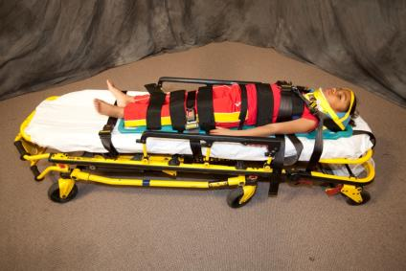
  Recommendation #4
  For a child whose condition requires spinal immobilization and/or lying flat.
The Ideal
  Secure the child to a size-appropriate spine board and secure the spine board to the cot, head first, with a tether at the foot (if possible) to prevent forward movement.
  Secure the spine board to the cot with three horizontal restraints across the torso (chest, waist, and knees) and a vertical restraint across each shoulder.

Slide 31
If the Ideal is not Practical or Achievable…
Secure the child to a standard spine board with padding added, as needed (to make the device fit the child) and secure the spine board to the cot, head first, with a tether at the foot (if possible) to prevent forward movement.
Secure the spine board to the cot with three horizontal restraints across the torso (chest, waist, and knees) and a vertical restraint across each shoulder.

Slide 32
  Recommendation #5
  For a child or children who require transport as part of a multiple patient transport (newborn with mother, multiple children, etc.) Consult child restraint manufacturers’ guidelines to determine optimal orientation for the child restraint (i.e., rear-facing or forward-facing) depending on the age and size of the child.
  The Ideal
  If possible, for multiple patients, transport each as a single patient according to the guidance shown for Situations 1 through 4.
  Transport in the forward-facing EMS provider’s seat /captain’s chair, which is currently rare in the industry) in a size-appropriate child restraint system that complies with FMVSS No. 213.
  For mother and newborn, transport the newborn in an approved size-appropriate child restraint system that complies with the injury criteria of FMVSS No. 213 in the rear-facing EMS provider seat /captain’s chair) that prevents both lateral and forward movement, leaving the cot for the mother. Use a convertible seat with a forward-facing belt path). Do not use a rear-facing only seat in the rear-facing EMS provider’s seat. You may also use an integrated child restraint system certified by the manufacturer to meet the injury criteria of FMVSS No. 213.
      PLEASE NOTE: A child passenger, especially a newborn, must never be transported on an adult’s lap. Newborns must always be transported in an appropriate child restraint system. Never allow anyone to hold a newborn during transport.

Slide 33
If the Ideal is not Practical or Achievable…
When available resources prevent meeting the criteria shown for the previous Situations 1 through 4 for all child patients, including mother and newborn, transport using space available in a non-emergency mode, exercising extreme caution and driving at reduced (i.e., below legal maximum) speeds.
If additional ground ambulances may be needed based upon preliminary information, request additional ground ambulances to help with transport as soon as possible.

Slide 34
-Current Options-
The sampling of products is not intended to be all inclusive or imply endorsement or crashworthiness of products.

Slide 35
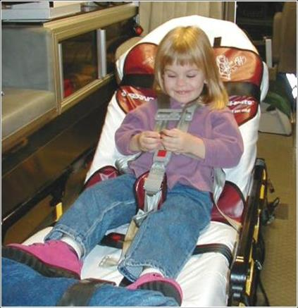
Ferno Pedi-Mate
Technical Specifications:
  Width: 32" (80 cm) Depth: 19" (48 cm) Weight: 3 lb. (1 kg) Load Capacity: Weight: 40 lb. (18 kg)
Features:
  Uses three restraint straps to attach quickly, easily and securely to most Ferno cots
  Fully-adjusting five-point harness system fits each child firmly and provides safe control during transport
  Securely holds children from 10-40 lb. (4.5-18 kg)
  Rolls compactly allowing for efficient storage and retrieval Made from nontoxic, easy-to-clean vinyl

Slide 36
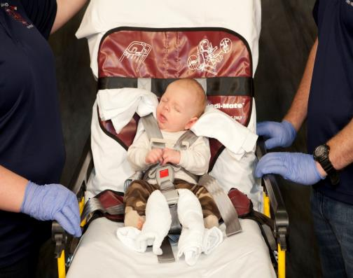
Important Points
Additional padding may be required for best fit

Slide 37
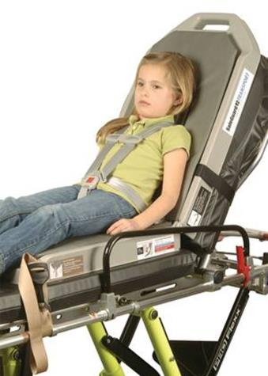
SafeGuard Transport
Technical Specifications:
  Folded Dimensions: Width: 17" Depth: 6.5" Height: 29.5”
  Weight: 22 lbs. (10 kg) Load Capacity: Weight: 100 lbs. (45.5 kg)
Features:
  One operation tightens the five-point harness and adjusts the height, securing the child within seconds.
  Snap hooks with color-coded webbing make attachment to cots quick and easy.
  Moves with the cot backrest to accommodate multiple positions from horizontal to 70 degrees, allowing easy access to the patient during transport.
  Securely holds children from 22-100 lbs. (10-45.5 kg)
  Seamless foam pad is impervious to body fluids and is designed to facilitate easy cleaning

Slide 38
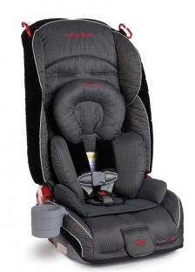
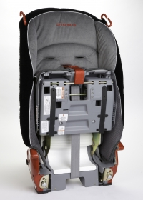
Radian R120
Technical Specifications:
  Folded Dimensions: Width: 17" Depth: 7" Height: 28.5”
  Open Dimensions: Width: 17” Depth: 16” Height: 28.5”
  Weight: 23 lbs. (10 kg)
Features:
  Accommodates children 5-35 lbs rear facing
  Accommodates children 20-80 lbs forward facing with a 5 point harness
  Installs on stretchers and captain chairs
  Includes full body support for optimal fit and comfort of infants
  Steel frame and EPS foam for superior performance
  Folds flat to 7” for easy storage

Slide 39
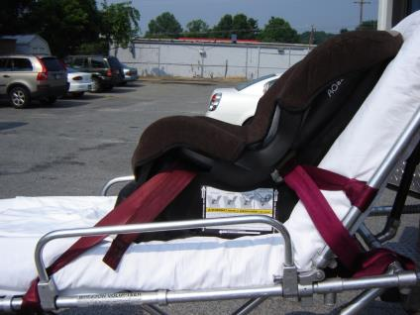
Traditional Car Seat
Technical Specifications:
  Variable depending on car seat
Features (depending on seat):
  May accommodate children 4-35 lbs rear facing
  May accommodate children 20-65 lbs forward facing with a 5 point harness
  Can install on stretchers and captain chairs but may be difficult and is dependent on belt path – a minimum of 2 belt paths are required
Ensure child is secure in seat according to car seat manufacturer specifications and seat is securely fastened to stretcher with minimal movement in all possible directions.

Slide 40
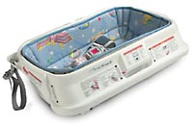
Infant Car Bed
Technical Specifications:
  Variable depending on car bed
Features (depending on car bed):
  Recognized by the American Academy of Pediatrics for transporting preemies, low birth weight infants and other medically fragile infants who must ride lying down
  May accommodate infants 5-20 lbs
  May accommodate infants 19-26" long
  Can install on stretchers – a minimum of 2 belt paths are required

Slide 41
CRASH PROTECTION FOR CHILDREN IN AMBULANCES
Recommendations and Procedures*
Marilyn J. Bull, M.D., Kathleen Weber, Judith Talty, Miriam Manary
A joint project of the Indiana University School of Medicine and the University of Michigan Medical School and Transportation Research Institute presented at the 45th Annual Proceedings, Assoc. for the Advancement of Automotive Medicine, 2001
Recommended method for restraining children up to about 18 kg who can tolerate a semi-upright seated position, showing belt attachment to the cot and routing through the
convertible child restraint
Recommended method for restraining infants who cannot tolerate a semi-upright seated position, showing belt attachment to the cot and routing through the car bed loops.

Slide 42
Integrated Child Restraints in Ambulances
May provide solution for transporting uninjured children who must ride in the rear compartment
•May improve ease of child restraint use for EMS personnel
•Some models may provide EMS occupant protection via a 3 or 4-point lap/shoulder belt when integrated restraint not in use

Slide 43
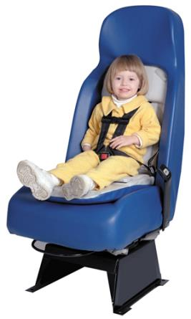
Integrated Car Seat
EVS 1850 Hi-BAC Safety Seat
Technical Specifications:
  48” Overall seat height (on base)
  28” Seat depth (edge to wall)
  18” Seat width
Features:
  Designed for the UNINJURED child between 20-50 lbs and between 28-47 inches tall. Child must be capable of sitting upright alone.
  NOT to be used by children less than 1 year of age or do not meet weight/height requirements

Slide 44
Guardian Safety Seat by Serenity Safety Products
3 in 1 attendant seat with built-in infant only seat, toddler restraint, and 4-point restraint for attendant
•Contact manufacturer for crash test information
1-800-536-0676
www.SerenitySafetyProducts.com

Slide 45

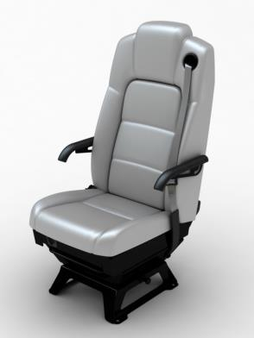
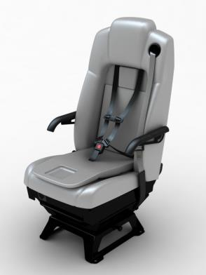
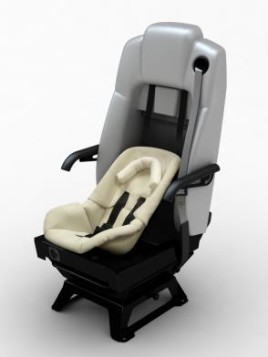

Slide 46
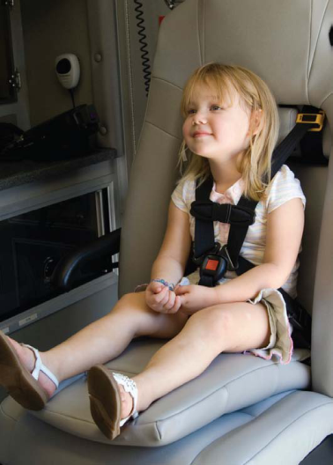
Guardian Safety Seat by Serenity Safety Products
Toddler and larger child integrated seat folds down
•For children 22-85 pounds

Slide 47
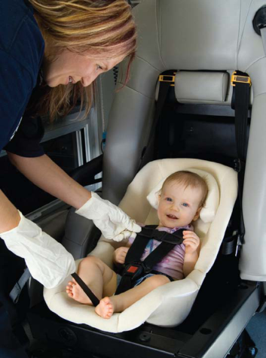
Guardian Safety Seat by Serenity Safety Products
Infant-only seat 5-22 lbs
•Faces rear of ambulance
•Stores in the back compartment of the ambulance seat

Slide 48
Children In Ambulances – Just the FACTS:
Currently, there are no Federal Motor Vehicle Safety Standards to define performance criterion for child restraint use in ambulance patient compartment
Research to date has been PILOT and not replicated
Today – there will be transports of children in ambulances across the country
SO - Consider:
Demographics of the children you will transport in both scheduled or non-scheduled transport
Types of devices you currently have – SAFETY for today
Types of devices you would like to have – Best Practice for tomorrow
  Fleet size
  Cost of devices
  Location for SECURE storage inside the ambulance
  Ease of installation and harness procedures when securing a child
  Ease of cleaning the device
  Training time required for correct use

Slide 49
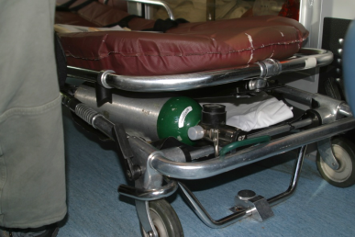
Other Dangers that Exist
Loose, unsecured equipment
Sharps containers
Unbelted providers

Slide 50
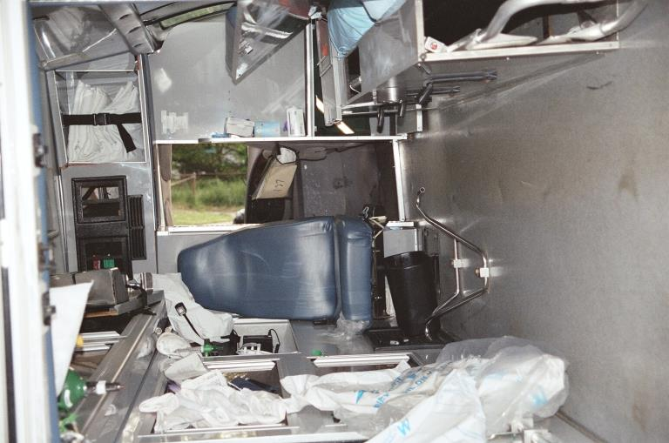
An actual ambulance crash in Maryland

Slide 51
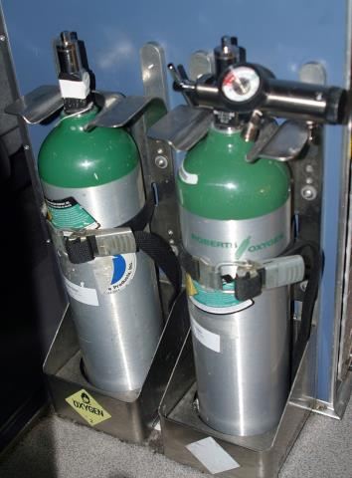
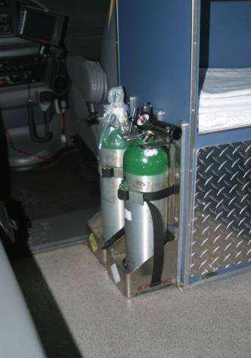
Oxygen tanks:
“Crash rated brackets”

Slide 52
Right Care When It Counts:
SECURE Transport of Children in EMS vehicles
Right Child: Injured - splinted and immobilized; Sick – restrained in the right seat (see below); Critical – secured to the stretcher with the most appropriate device available using all available straps
Right Seat: be sure the manufacture has certified it for the estimated height and weight of the child (yes you may estimate if no parent is there to give you a weight using length –weight based system or chart)
Right Installation: Child safety seat or device is installed in vehicle properly (read the directions and do training ahead of time)
Right Use: Vehicle seat and stretcher straps and harness are used properly (read the directions and do training ahead of time)
Remember to restraint everyone & everything else too !

Slide 53
Best Practices for Safe Transport of children is an ongoing discussion
What we DO know:
  NO side facing CRS seats (no bench seats)
  NO CRS with safety screen in Police Cars
  NO infant CRS (they have rocker bottoms and in pilot testing flipped 180 – 360 degrees)
  NO parent holding CRS with child
  NO parents holding children on stretcher
  NO loose objects
  There is a lot more research needed!

Slide 54

Thank you to the following resources in Maryland and across the country for their input and use of their images – the field is evolving – Stay Tuned!
EMSC Federal Program
NHTSA EMS Division
NHTSA Occupant Protection Division
CNMC Pediatric Transport Team (DC)
CHIP - EMS Education Program (Pittsburgh)
Riley Children’s Hospital & Dr. Marilyn Bull
Montgomery County Fire & Rescue- CPS Program
Manufacturers website
Thank You
&
The End

Slide 55
Thank you for participating today!
Final Instructions:
Evaluation form is available on our website: http://www.miemss.org/EMSCwww/CPSHome.htm; alternatively, we can email it to call participants.
Return your completed evaluation along with the contact info page to receive CPST certificate.
EMS providers must complete a roster with Provider ID # for continuing education.
The full presentation with audio will be available on our website in a couple of weeks, in case you wish to re-visit it, or refer a colleague to it.

