Slide 1
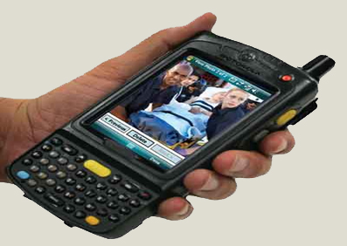
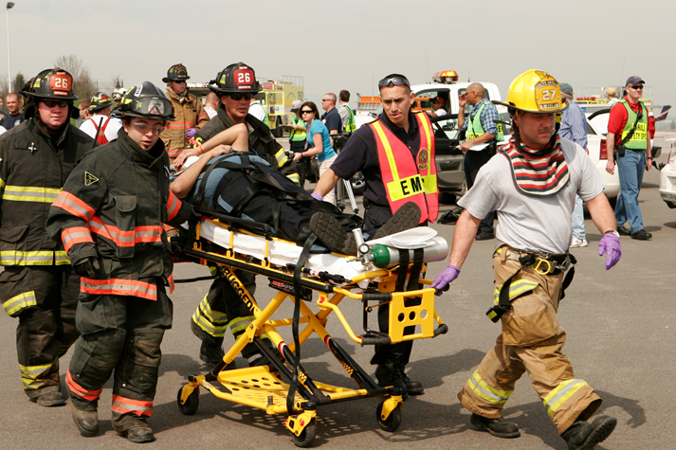
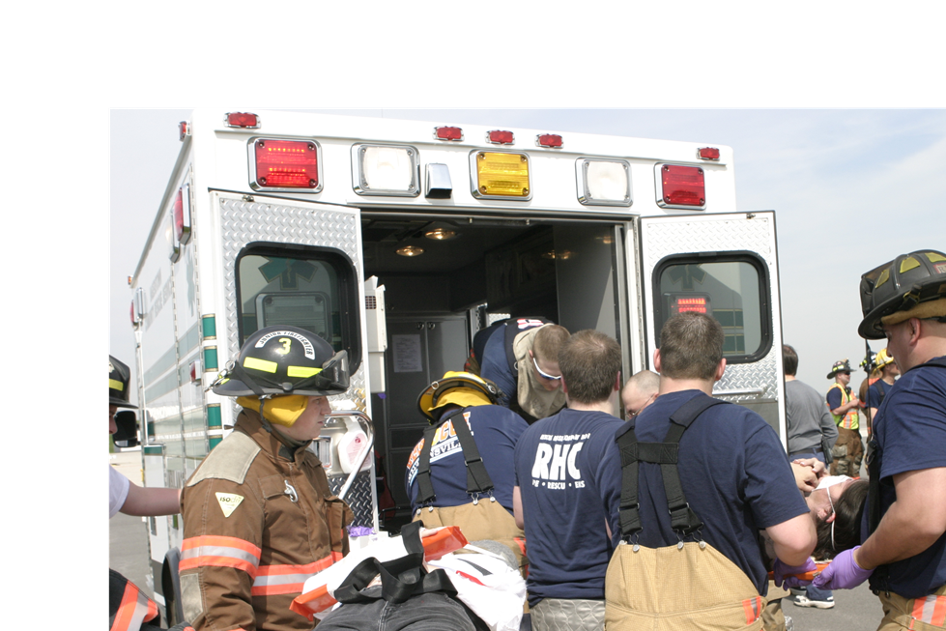
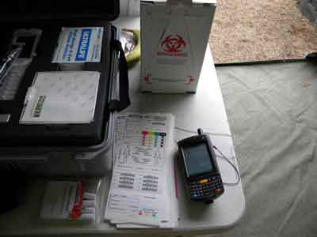
Maryland Triage System Incident Command
Notes:
INSTRUCTOR NOTES:
Introduction slide. The program may be taught in a group setting or self-taught.

Slide 2
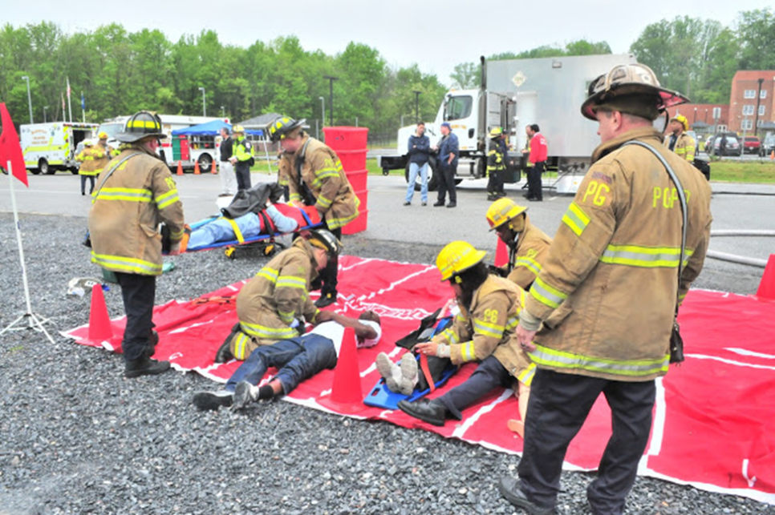
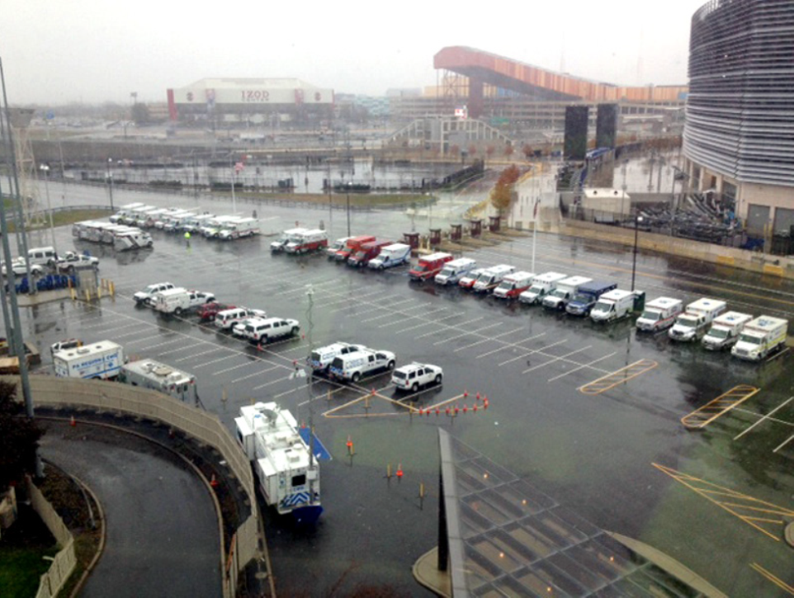
Establishing the Multi-Casualty Incident Command System
The program highlights appropriate components of the National Incident Management System (NIMS) related to Emergency Medical Services
Notes:
INSTRUCTOR NOTES:
Begin the discussion of ICS for EMS. This should just be an overview to remind the student of the system structure. Emphasis should only be placed on the multi-casualty portion of the system. If there are time constraints, the instructor may choose not to go into great detail.

Slide 3
Enabling Objectives
Upon completion of this training the participant
will be able to:
Identify the positions and the organizational structure of the Incident Command System (ICS) as it applies to a Multi-Casualty Incident
Explain the responsibilities of the first unit arriving on scene
Explain patient flow through the ICS Multi-Casualty structure
Notes:
INSTRUCTOR NOTES:
The program will also review some of the basic principles of START and JumpSTART triage and ICS to remind the student of information they should have already learned and to tie together that information with the use of the triage tag, the HC handheld, and patient flow.

Slide 4
Notes:
This shows a large build out of a major incident with several medical groups that may exist in multiple locations. It should be noted that under Operations you may have Medical Group Supervisors for treatment of patients only. There may also be a Medical Unit with a Leader under the Logistics Section that is there for the treatment of the personnel working on the incident.

Slide 5
Initial EMS Response
Notes:
At a minimum these positions should be utilized in any multi-patient incident. The system can be expanded depending on the number of patients.

Slide 6
Patient Flow
Incident Site
Casualty
Collection
Point
Triage Unit Leader
Morgue
Manager
Treatment Unit Leader
Red Immediate Manager
Yellow Delayed Manager
Green Minor Manager
Hospital A
Hospital B
Treatment Dispatch Manager
Hospital C
Staging Manager
Transportation Group Supervisor
Hospital D
Medical Communications Coordinator
Disposition Coordinator
Ambulance Transport
Notes:
This is a schematic drawing of how the hierarchy may be deployed geographically at the incident site. The functions and reporting lines remain as in the previous organizational chart. The Casualty Collection Point could also be established between the Triage Unit Leader and the Treatment Unit Leader rather than prior to the Triage Unit Leader or at the treatment site.
INSTRUCTOR NOTES:
STRESS TO STUDENTS:
1. First unit to arrive must keep in mind that this schematic is the goal.
2. They must not just jump into treating patients or the entire infrastructure will fall apart and total chaos will ensue.
3. Relate back to how these areas fit into Incident Management System (IMS).

Slide 7
First Unit/Incident Command
Assess and Secure the Scene
Ensure safety
Establish or assume command
Direct incoming units
Request additional resources
(Order Early and Order Big)
Establish Triage Unit Leader
Notes:
INSTRUCTOR NOTES:
Relate to your students what the radio transmission of the first arriving unit might be in your jurisdiction.
“Paramedic Engine 703 to communications. We have a collision involving two buses. I am establishing command and requesting four Medical Strike Teams with Rescue. Have the first team begin Triage and the second team establish the Treatment Area at the 7-Eleven parking lot. The third team should stage in the Kindercare Lot.” “Advise EMRC of the incident and that we could be transporting approximately 60 patients. Ask them to begin a hospital call-down. We will contact them for hospital status.”

Slide 8
First Unit/Incident Command
Establish Medical Communications Coordinator
Notify hospitals (EMRC)
Establish initial Treatment Area
Establish Transportation Group (when personnel available)
Maintain the 5 S’s of the Multi-Casualty Incident:
Safety, Size-up, Send, Set Up, and START/JumpSTART Triage
Notes:
INSTRUCTOR NOTES:
The IC should begin the build out of the command structure as units arrive. It is important to make sure Triage is performed first and no immediate treatment other than life-saving measures administered until additional help has arrived. If Triage is completed then that crew can be reassigned or begin treatment.
Maintain the 5 S’s of the Multi-Casualty Incident:
Safety, Size-up, Send, Set Up, and START/JumpSTART Triage

Slide 9
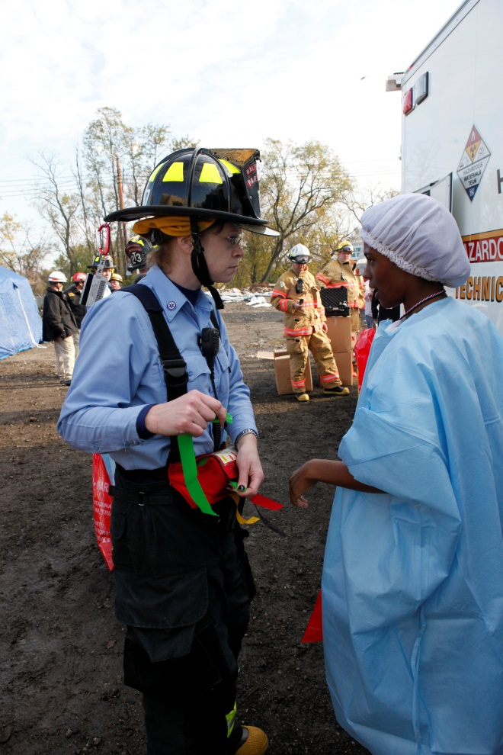
Triage Unit Leader
Coordinate with Treatment Unit Leader to determine if triage will be conducted in:
Incident/extrication area
Designated Casualty Collection Point (CCP)
Treatment area
Approximate number and severity of victims
Report this information to command
Supervise:
Triage Teams
Porter Teams (Litter Bearers)
Additional resources
Notes:
INSTRUCTOR NOTES:
Triage Unit Leader is the first arriving suppression unit after hazards are addressed. He or she assumes responsibility for providing triage management and movement of patients from the Triage Area.
Maintain the 5 S’s of the Multi-Casualty Incident:
Safety, Size-up, Send, Set Up and START/JumpSTART Triage
Be sure to stress universal precautions and scene safety. The Triage Unit Leader must be vigilant.

Slide 10
Triage Unit Leader
Ensure safety of all personnel
Ensure triage of patients is based on START or JumpSTART Algorithm
Primary Triage (ribbons only)
Communicate resource requirements to IC or Medical Group Supervisor
Provide frequent progress reports
Establish Morgue if necessary
Notes:
INSTRUCTOR NOTES:
Maintain the rule of 60 seconds or less per patient contact time.
Law Enforcement should be requested to assist in securing the scene.
The morgue area is initially the responsibility of the Triage Unit Leader. The expired patients must remain in place as this is a potential crime scene. The living patients should be triaged and then moved to the treatment area, and the deceased should be black-ribboned or black-tagged. Do not move deceased patients until after consultation with police or medical examiner. Only patients that die in treatment area should be moved to the morgue until after the scene has been secured and the medical examiner has approved the movement of the scene dead.

Slide 11
Treatment Unit Leader
Identify and establish Treatment Areas
Consider weather, size, accessibility, safety,
and hazmat potential
Assign Treatment Area Managers
Notify IC of Treatment Area locations and give status report
Notes:
INSTRUCTOR NOTES:
Persons may leave incident site in several directions. ALL patients must be logged and accounted for by the Treatment Unit Leader.
People must be posted to direct litter bearers to Treatment Unit Leader.
Law Enforcement should be requested to assist in securing the scene.
Casualty Collection Point (CCP) should be established prior to patients entering treatment areas.

Slide 12
Treatment Unit Leader
Establish communications with Triage Unit Leader
Ensure each patient is issued a MIEMSS Triage Tag and does NOT leave area without one attached
Utilize Patient Tracking Scanners (PTS) and/or Treatment Area Manager logs to track patients for each area

Slide 13
Treatment Unit Leader
Request sufficient medical caches and supplies as necessary
Provide access for Medical Care Support Units (MCSU)
Establish communications with patient Transportation Group Supervisor
Consider delegating this task to Treatment Dispatch Manager
Maintain accountability/safety for all patients and personnel
Assess mental and physical well being of personnel
Notes:
Make sure all patients are issued a triage tag and that it is attached to the patient for identification. If the patient tracking scanners are available, utilize them IN ADDITION to placing a triage tag on the patient.

Slide 14
Treatment Area Managers
Red Immediate Manager
Yellow Delayed Manager
Green Minor Manager
Define Entry and Exit points
Clearly identify each area and delineate each area’s boundaries.
Morgue needs to be distant from treatment areas
Prepare equipment and supplies
Brief Treatment Crew(s)
Ensure Secondary Triage is completed
Ensure each patient has been issued a Triage Tag
Utilize Patient Tracking Scanners (PTS) to log patients or prepare and maintain a Treatment Log Sheet
Notes:
INSTRUCTOR NOTES:
Stress single entry and exit points
Placement of morgue should not be near treatment areas
Use colored ribbons, flags, and/or colored tarps for identification purposes
Fill out triage tags properly. Re-triage and relocate patients as necessary.
Prioritize patients to be transported.
Request resources as necessary.

Slide 15
Treatment Dispatch Manager
Receive information from Treatment Area Managers
Establish and maintain communications with Medical Communications Coordinator
Coordinate with Treatment Managers and Medical Communications Coordinator to transport patients to appropriate medical facilities
Utilize Patient Tracking Scanners (PTS) for patient movement and/or mark the hospital destination on Transport Record of the Disaster Triage Tag
This position is often combined with another position
Notes:
INSTRUCTOR NOTES:
The Treatment Dispatch Manager is responsible for communication and coordination of the patients ready for transport out of the treatment areas to the transportation area and makes sure transportation is ready to receive patients prior to moving patients to that area.

Slide 16
Transportation Group Supervisor
Establish One Way Traffic Flow: There should always be a clear, unobstructed flow of transport units in and out of the transport area. Transport units should pull up, load, leave, but NOT execute a back-up of the vehicle
Utilize Patient Tracking Scanner (PTS) and/or prepare and maintain a Log Sheet
Establish exit point
Assign Communications (SYSCOM/EMRC) and Air/Ambulance Disposition Coordinators
Notes:
INSTRUCTOR NOTES:
Locate near transportation area if possible. Establish and maintain vehicle movement corridor.
Stress Importance of ONE WAY FLOW. Direct units to avoid backing up if at all possible to load patients.
Backing up
- causes injuries
- tends to restrict flow
- slows process
Stress concerns over exhaust and unexpected movement from idling vehicles.

Slide 17
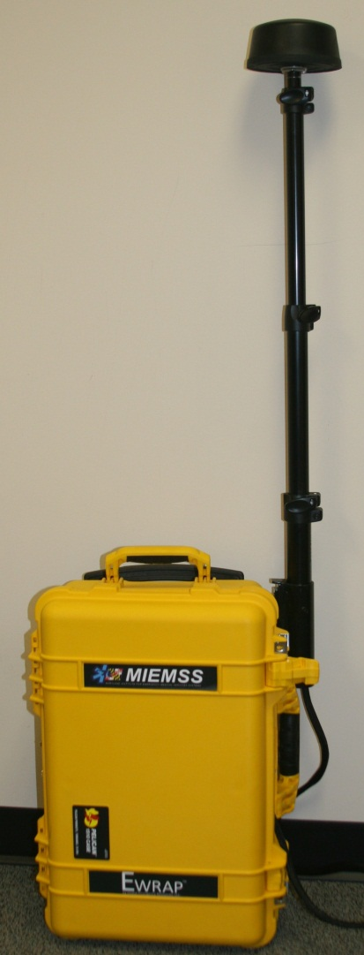
Medical Communication Coordinator
Contact EMRC/Communications Center
Advise type of incident
Provide location
Describe incident
Provide approximate patient count
(by priority if possible)
Request call down of hospitals
Establish Communications Log
Deploy Emergency Wireless Routing
Access Point (EWRAP)
Notes:
INSTRUCTOR NOTES:
Establish and maintain a Communication Log which is simply a chronological listing of all communications including:
time
contact point
brief message
Establish and maintain communications with EMRC.
Assign SPECIFIC hospital destinations and relay this information to Air/Ground Ambulance Disposition Coordinator.

Slide 18
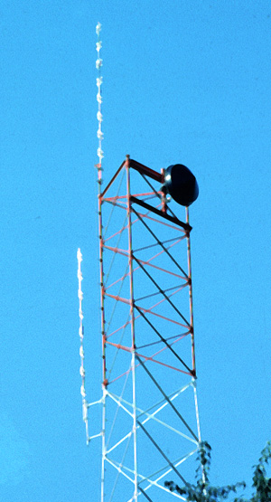
Medical Communication Coordinator
Receive bed availability from Communications Center
Communicate availability to
Ambulance Disposition Coordinator
Update hospitals on incident status
every 30 minutes
Advise hospital(s) when incident is terminated
Notes:
INSTRUCTOR NOTES:
The EWRAP (Emergency Wireless Routing Access Point) is a small, portable device that can be utilized in remote environments to provide secure wireless connections allowing patient information and tracking data sharing among the HC handheld, laptops, the EMRC, MIEMSS, and receiving facilities. It may be connected to multiple power sources including vehicle batteries, generators, solar cells, or an AC source. It supports operating distances of up to ½ mile for typical WiFi devices. It requires no user intervention and makes automatic information routing decisions. Multiple EWRAPS at the scene mesh seamlessly to create a high speed local network, allowing audio and video capture for situational awareness.

Slide 19
Air/Ground Ambulance Disposition Coordinator
Receive bed availability from
Medical Communication Coordinator (EMRC)
Prepare log sheet for each hospital and their “tickets”
Update information on Patient Tracking Scanners (PTS)
Notes:
INSTRUCTOR NOTES:
Communication and Disposition Coordinator must establish a good rapport and a system to share information. This should be done before patients begin to flow through area.

Slide 20
One Way
Notes:
INSTRUCTOR NOTES:
Discuss the importance of ambulance flow peripheral to (not through) the incident. Ideally the flow should be one-way. Some geography, road damage and circumstances may not permit this.

Slide 21
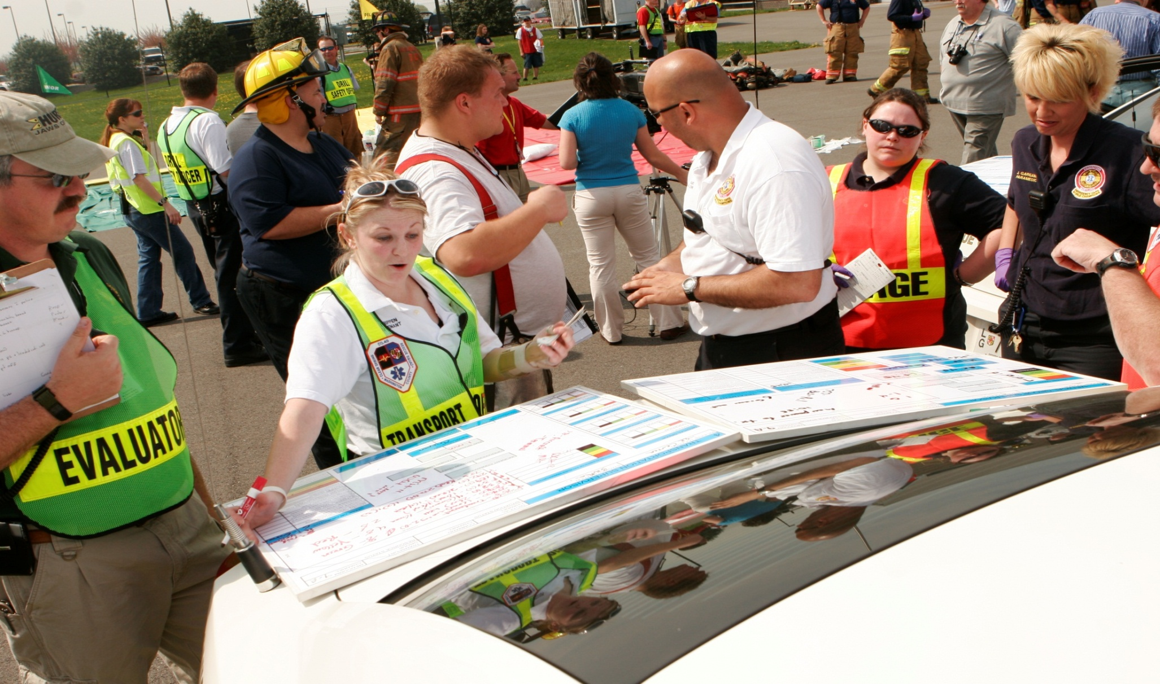
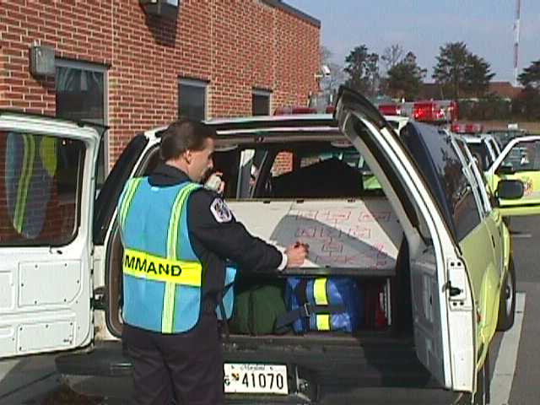
Tracking Patient Flow
Notes:
INSTRUCTOR NOTES:
This section will track the flow of patients through the system using the ICS structure and emphasize how the triage tag components come into play at each stage.

Slide 22
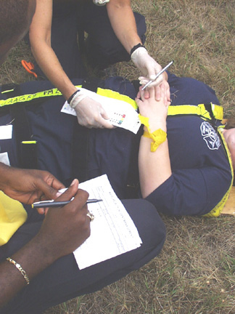
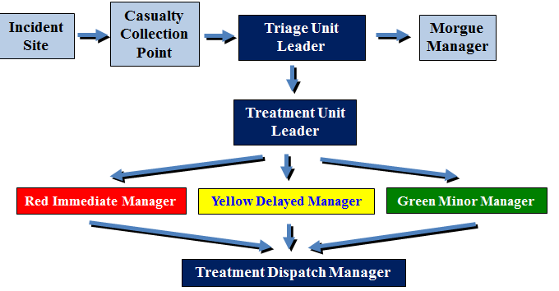
Treatment Unit Leader
Attach triage tag to ribbon
Each patient must receive a
triage tag
Circle priority at initial
assessment
Notes:
INSTRUCTOR NOTES:
Colored ribbon stays on the patient and the triage tag is attached to it.

Slide 23
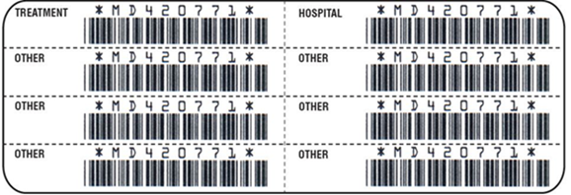
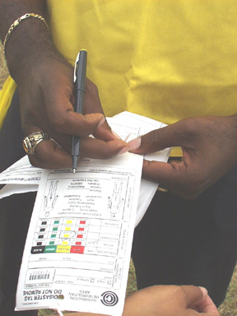
Treatment Unit Leader
Scan Bar Code on triage tag with Patient Tracking Scanner (PTS)
Or remove treatment peel-off label and place on treatment log
PTS will place a time stamp on patient record
Otherwise note time on tag
Notes:
INSTRUCTOR NOTES:
Patient tracking really begins at this stage.

Slide 24
Treatment Unit Leader
Red Immediate Patients
Yellow Delayed Patients
Direct crew to appropriate patient area
Green Minor Patients
Morgue
Notes:
INSTRUCTOR NOTES:
The Treatment Unit Leader is responsible for ensuring that the treatment areas are staffed and equipped.

Slide 25
Treatment Area Managers
Scan patient’s triage tag with PTS
Or log patient into area
Take “other” barcode label
and place on log
Notes:
INSTRUCTOR NOTES:
Utilize the “sticky” labels from the triage tags to track patient flow as well as mark personal effects.

Slide 26
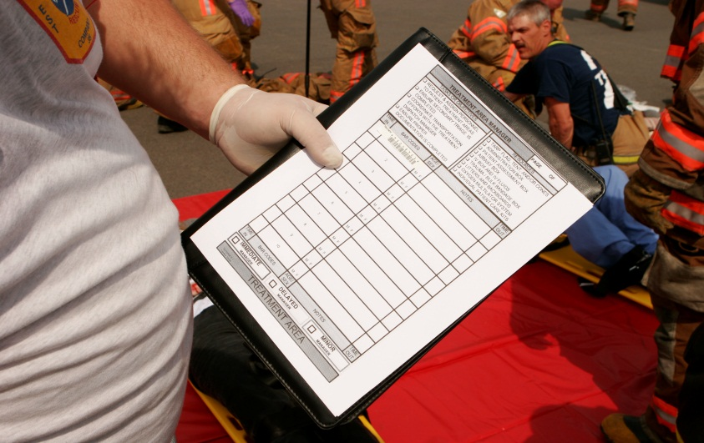
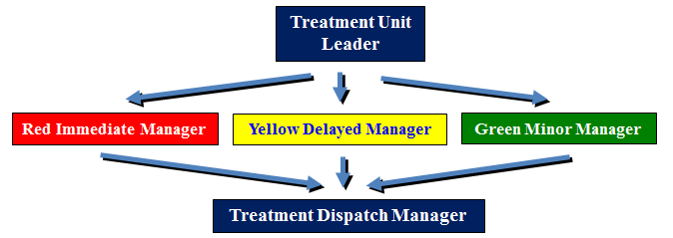
Treatment Area Managers
Assign crew to care for patient
Reassess ABC’s
Stabilize life threatening conditions (airway, needle decompression, tourniquet, antidote)
Immobilize
Treat major fractures
Package patient for transport to appropriate facility
Utilize Patient Tracking Scanner (PTS) to note assessment and treatment interventions and/or on triage tag
Ensure patient can be transported safely
Notes:
INSTRUCTOR NOTES:
Typically, in an MCI, rapid transport of the seriously ill/injured is key to a successful outcome. The objective is to ensure that the patient can be transported in a safe manner (e.g., patent airway, immobilized on backboard).
If established, coordinate with the Treatment Dispatch Manager before moving patient out of treatment areas.
If Treatment Dispatch Manager is not established, wait for the Transportation Group Supervisor authorization before moving patients out of the Treatment Area.

Slide 27
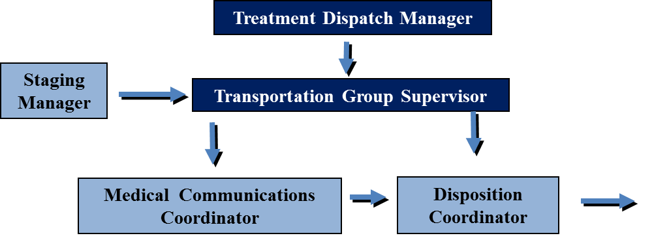
Transportation Group Supervisor
Coordinate loading of patients
Assign
Medical Communication Coordinator
Air/Ambulance Disposition Coordinator
Notes:
INSTRUCTOR NOTES:
Transportation Group Supervisor and Medical Communications Coordinator positions should not be duplicated in an incident. This helps prevent confusion on how many and which patients are going to a specific hospital. There may be multiple Disposition Coordinators at different locations that communicate with the Transport Group Supervisor.

Slide 28
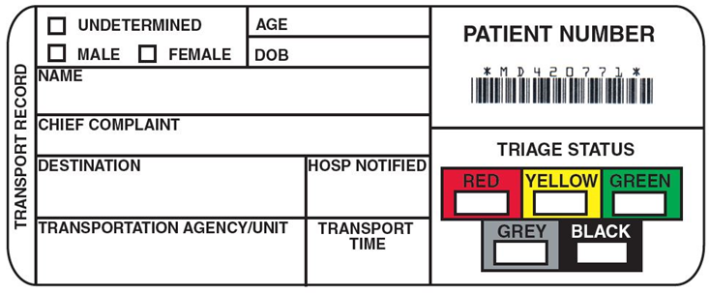
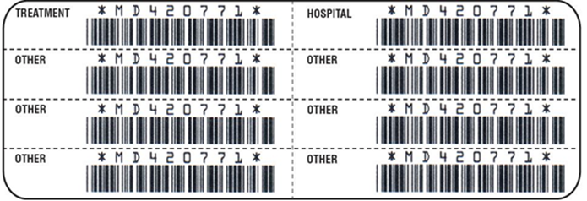
Transportation Group Supervisor
Patient Loading
Contact Staging for transport units
Contact Treatment Dispatch Manager /Treatment Areas for patients ready to load
Scan triage tag and insert Unit Number and Priority
Write information on tear-off transportation record section (commonly called “Ticket”) part of triage tag
Scan with PTS or peel off a
barcode label and place
on log sheet
Notes:
INSTRUCTOR NOTES:
Remind students that ambulatory (MINOR or GREEN) patients may be transported in the front seat of the ambulance and in other vehicles such as buses, utility units, etc.

Slide 29
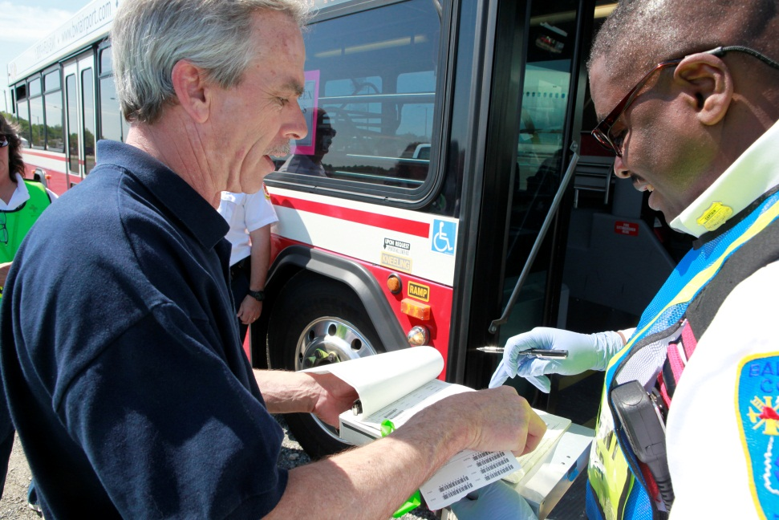
Patient Loading
Load patient into
transport unit
Tear off Transportation Record (“Ticket”) and hand to driver
Notes:
INSTRUCTOR NOTES:
Remind the students that the Transportation Group Supervisor must direct the driver to see the Ambulance Disposition Coordinator. The Ambulance Disposition Coordinator will determine the designated facility to which the patient is to be transported.

Slide 30
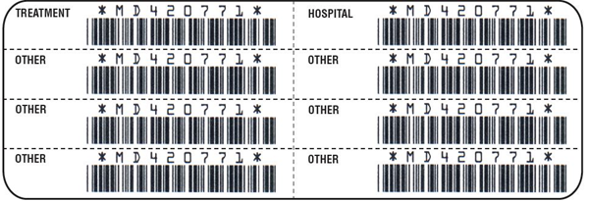
Patient Loading
Remind provider to update or
complete Transport Line on
the PTS or Tag once hospital is assigned
On hospital arrival, place Barcode Labels on official printout copies of the Electronic Patient Care Report (ePCR) or electronic Maryland EMS Data System (eMEDS) and hospital chart
Notes:
INSTRUCTOR NOTES:
Remind the provider to fill out TRANSPORTATION line and place labels on ePCR/eMEDS printout sheets.

Slide 31
Medical Communication Coordinator
Receive ticket from Ambulance Disposition Coordinator
Communicate information to hospital
Unit, jurisdiction, and number
Number of patients with priority of each
Initial ticket in the “Notified” field
Notes:
INSTRUCTOR NOTES:
Hospitals do not need much more information during a MCI. HC Standard Handheld automates most of this process.

Slide 32
Patient Loading
Direct Transport Unit to
Ambulance Disposition Coordinator
Maintain One Way traffic flow
Do NOT have unit back up or back in
One Way
Notes:
INSTRUCTOR NOTES:
One way traffic flow, whenever possible, is crucial to smooth patient flow from the area.

Slide 33
Ambulance Disposition Coordinator
Receive Transport Record
(commonly called “Tickets”) from driver
Scan ticket with PTS
Select input and select destination
Hit the “Now Button”
Transport “Tickets” go from the driver to the Disposition Coordinator
Notes:
INSTRUCTOR NOTES:
The disposition coordinator will keep track of patient distribution, bed availability, and keep chain of command informed.
TRANSPORT TICKETS GO FROM THE DRIVER TO THE DISPOSITION COORDINATOR.

Slide 34
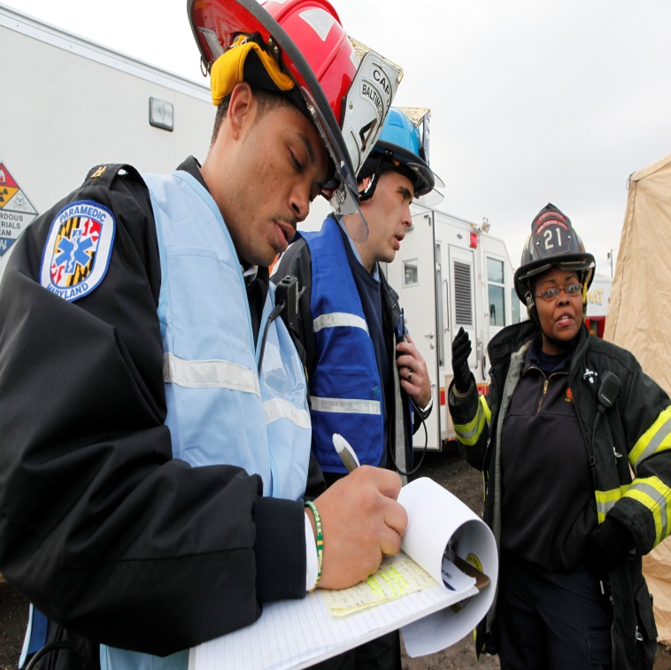
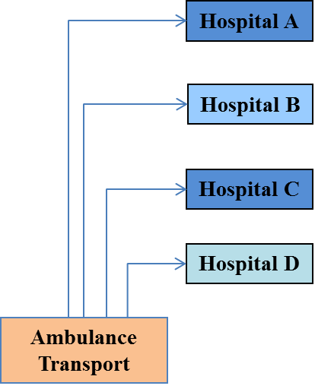
Ambulance Disposition Coordinator
Discusses the destination hospital (appropriate for patient condition) with the Medical Communication Coordinator
Ticket
Notes:
INSTRUCTOR NOTES:
This process can get quite confusing, and CAN SLOW the entire FLOW OF PATIENTS FROM THE INCIDENT. Be sure the process is clear between the two officers. Runners may be utilized to go between the ambulance and these officers.
Medical Communications Coordinator provides the available destination hospitals to Ambulance Disposition Coordinator. Once patient is assigned to hospital by Ambulance Disposition Coordinator, assignment is relayed to Medical Communications Coordinator.

Slide 35
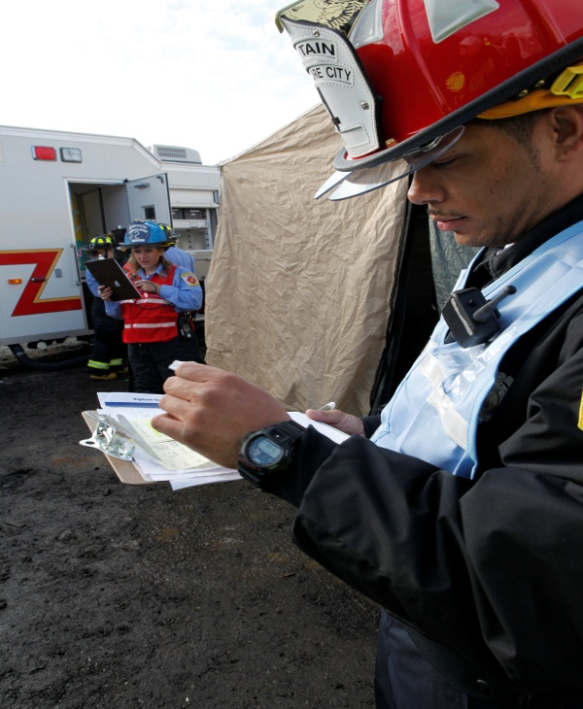
Ambulance Disposition Coordinator
Give driver destination and confirm directions
Insert hospital info on PTS
Write destination and transport time on ticket
Give ticket to
Medical Communication Coordinator
Patient Transport Recorder
Notes:
INSTRUCTOR NOTES:
Make sure the hospital destination is filled out and what time they left the scene.

Slide 36
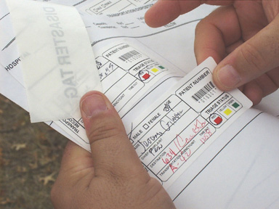
Ambulance Disposition Coordinator
Receives “ticket” back from Medical Communications Coordinator
Tracks available beds at hospitals
Scans barcode label with PTS
Places “ticket” label on
hospital destination logs and
notes time
Notes:
INSTRUCTOR NOTES:
The Ambulance Disposition Coordinator is a key position (and potential choke point) in the flow of information, tags/tickets, and patients.

Slide 37
The Process in Review
Incident Occurs
Walking wounded sent to Casualty Collection Point
Triage of Patients
Patient receives a ribbon by Triage Unit Leader or designee
Only attempt to life-saving interventions (Airway, Needle decompression, Tourniquet, Antidote)
Patient is moved to various treatment areas at direction of Treatment Unit Leader and receives triage tag and treatment
Notes:
INSTRUCTOR NOTES:
The next few slides are a review of the patient flow process for a full build out multi-casualty incident.

Slide 38
The Process in Review
Treatment Dispatch Manager coordinates with Transportation Group Supervisor/Patient Transport Recorder
Arranges for patient to be moved to transport vehicle
Triage tag to remain with patient at all times
EMS Staging Manager dispatches ambulance to designated pick-up area
Driver is given Transport Record “Ticket” piece of triage tag
Proceeds to Ambulance Disposition Coordinator
Notes:
INSTRUCTOR NOTES:
When the patient moves from the treatment area to the transportation area, the triage tag stays with the patient but the bottom part or “Ticket” is given to the driver. The driver will then proceed to the checkout position and hand the tag to the Ambulance Disposition coordinator or Transportation Group supervisor who will coordinate with the Medical Communications coordinator as to hospital transport location and information relayed to that hospital.

Slide 39
The Process in Review
Driver gives “Ticket” to Ambulance Disposition Coordinator
Coordinates with Medical Communication Coordinator for hospital availability and dispatch
Driver is given hospital transport information prior to leaving scene
Patient is transported to designated hospital
Arrival time should be placed on triage tag
Notes:
INSTRUCTOR NOTES:
The driver will then be given the hospital transport destination for his patient. On arrival at the hospital, the driver should note the time of arrival or advise the caretaker to note it on the PTS scanner for the patient.

Slide 40
Maryland Triage System
MIEMSS gratefully acknowledges the following individuals for their efforts in the development of this program:
Robert R. Bass, MD, FACEP
Executive Director
MIEMSS
Richard L. Alcorta, MD, FACEP
State EMS Medical Director
MIEMSS
David Stamey, CCEMT-P
Region II Administrator
MIEMSS
Amy Robinson, MS, EMT
Associate Region V Administrator
MIEMSS
Jeff Huggins, BS, EMT-I
Associate Region III Administrator
MIEMSS
Diane Zuspan, EMT-P
Division Chief
Montgomery County Fire & Rescue Service
Beth Sanford, EMT-P
Captain
Montgomery County Fire & Rescue Service
Jon Fiedler
Lieutenant (Retired)
Montgomery County Fire & Rescue Service
Newport Beach Fire and Marine
Funding Provided By Montgomery County Fire & Rescue Service
Through an Urban Area Security Initiative Grant

Slide 41
Maryland Triage System
Maryland Institute for
Emergency Medical Services Systems
653 West Pratt Street
Baltimore, MD 21201
410-706-3996

