Slide 1
EMR & EMT Students: How to Register for the NREMT Cognitive Exam
Rae Oliveira
Licensure & Certification – MIEMSS
7/2015

Slide 2
This presentation will cover:
How to create an account at NREMT
How to apply for your NREMT EMT or EMR Cognitive Examination
How to track your application status

Slide 3
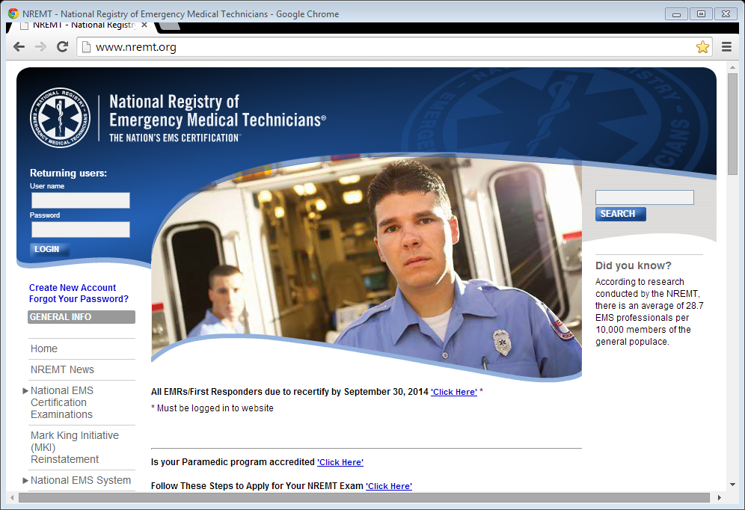
How to create an account at NREMT
Step 1: Open your web browser and type
www.nremt.org

Slide 4
How to create an account at NREMT
Step 2: Click on Create New Account

Slide 5
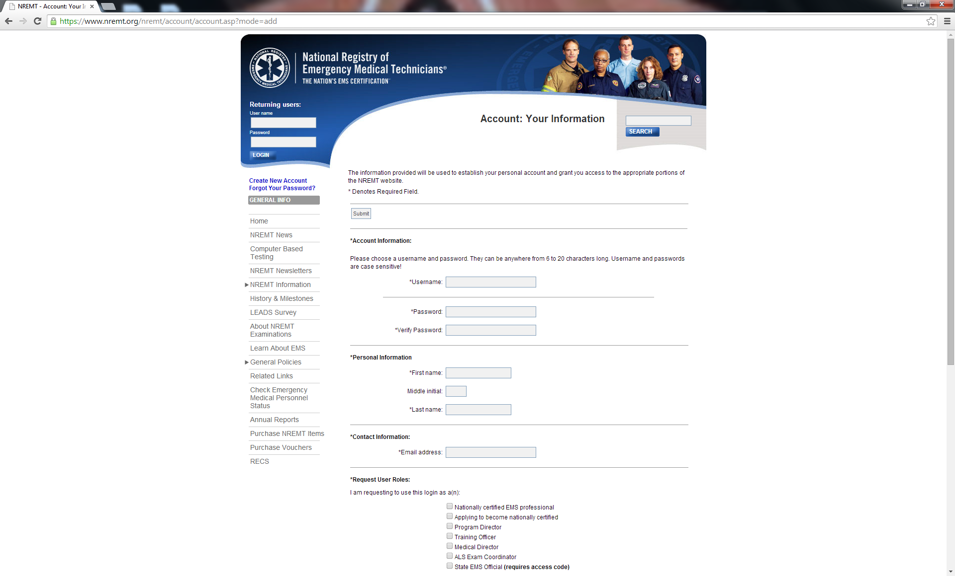
How to create an account at NREMT
Step 3: Fill in the requested information

Slide 6
How to create an account at NREMT
Step 3 continued:
Account Information – Enter a Username and Password (write it down, you will need it again)
Personal Information – Enter your First and Last name
Contact Information – Enter a valid e-mail address

Slide 7
How to create an account at NREMT
Step 3 continued:
Request User Roles – Check Applying to become nationally certified only!
Security Question – Complete the three questions
Submit your application

Slide 8
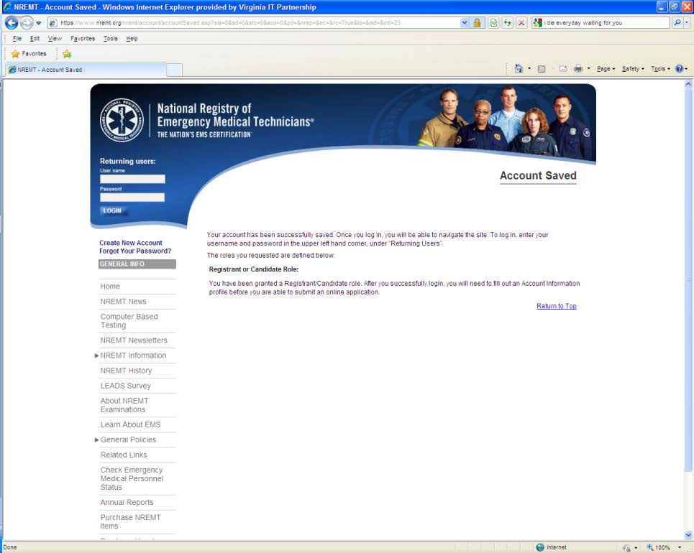
How to apply to take your NREMT Cognitive Examination
Step 4: Log into your NREMT account using your new Username and Password

Slide 9
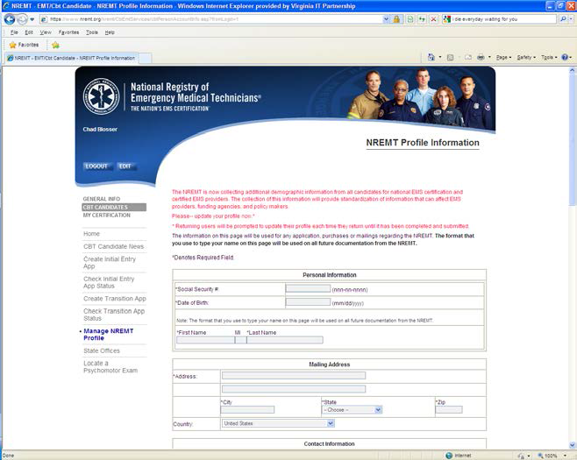
How to apply to take your NREMT Cognitive Examination
Step 5: Demographic Information

Slide 10
How to apply to take your NREMT Cognitive Examination
Step 5 continued:
Complete the demographic information and assure accuracy before submitting

Slide 11
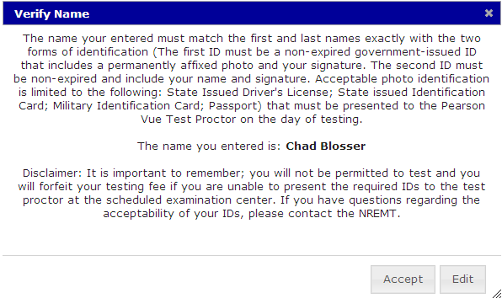
How to apply to take your NREMT Cognitive Examination
Step 5 continued: Please pay special attention to the name verification. This name must match your government issued ID (i.e. Driver’s License) in order to be admitted to the NREMT test site

Slide 12
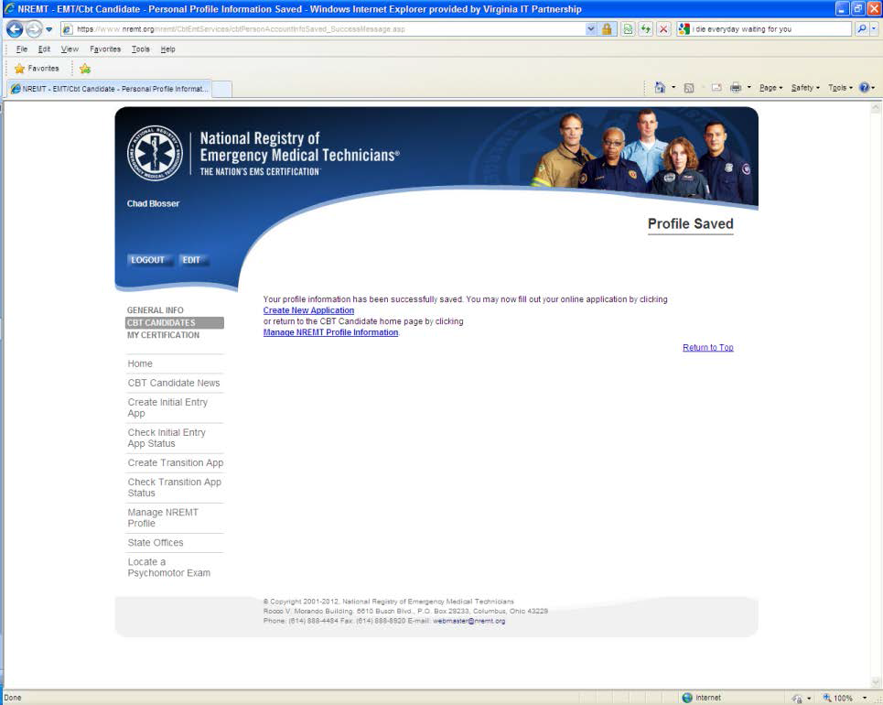
How to apply to take your NREMT Cognitive Examination
Step 6: Click on Create New Application

Slide 13
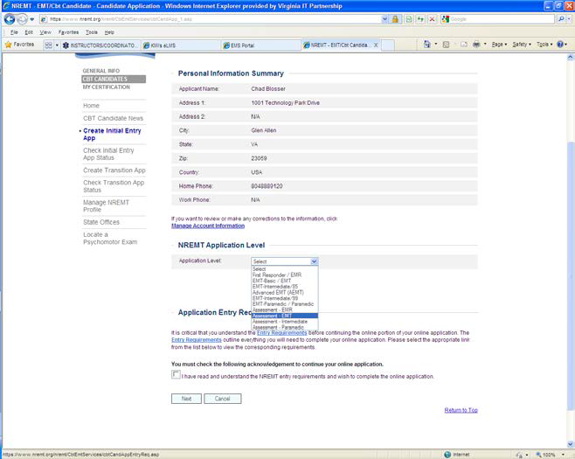
How to apply to take your NREMT Cognitive Examination
Step 7: Selecting Program Application Level
THERE ARE THREE TYPES OF BLS APPLICATIONS FOR MARYLAND STUDENTS

Slide 14
How to apply to take your NREMT Cognitive Examination
All EMR applicants will choose the EMR application
EMT application
If over 18 y/o at time of testing
See slides # 15- 19
Assessment EMT application
If UNDER 18 y/o at time of testing
See slides # 20- 22

Slide 15
How to apply to take your NREMT Cognitive Examination
Step 7 continued: EMT OVER 18 y/o !!!!!
Choose this application if you will be over the age of 18 at the time of testing
Personal Information Summary – Verify
NREMT Application Level –
Select the EMT application

Slide 16
How to apply to take your NREMT Cognitive Examination
Step 7 continued: OVER 18 y/o !!!!!
Application Entry Requirements
Read the requirements
Check the box indicating that you have read and understand the entry requirement
Click Next

Slide 17
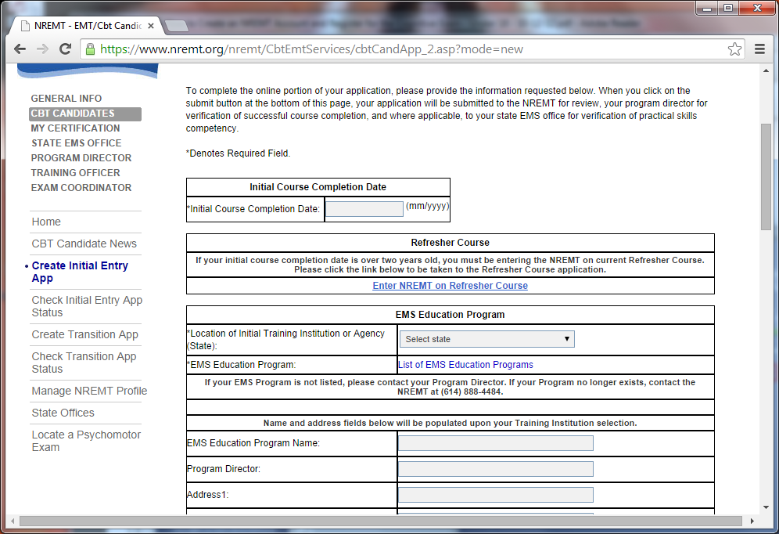
How to apply to take your NREMT Cognitive Examination
Step 7 continued: OVER 18 y/o !!!!!

Slide 18
How to apply to take your NREMT Cognitive Examination
Step 7 continued: OVER 18 y/o !!!!!
DO NOT select Enter NREMT on Refresher Course !
Enter your EMS Education Program information
Make sure you select the correct program – special attention to MFRI students as there are multiple locations

Slide 19
How to apply to take your NREMT Cognitive Examination
Step 7 continued: OVER 18 y/o !!!!!
Read the affirmation statement
Click Submit

Slide 20
How to apply to take your NREMT Cognitive Examination
Step 7 continued: EMT UNDER 18 y/o !!!!!
Choose this application if you will be under the age of 18 at time of testing
Personal Information Summary – Verify
NREMT Application Level –
Select the Assessment - EMT application
Click Next

Slide 21
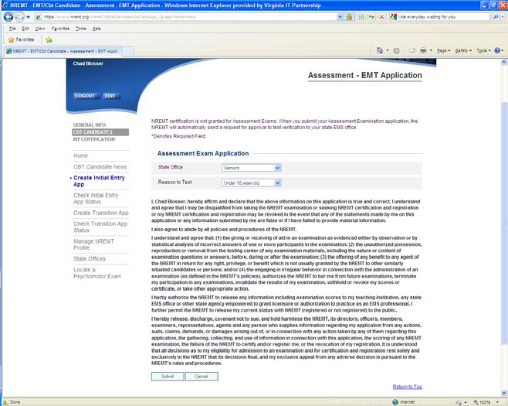
How to apply to take your NREMT Cognitive Examination
Step 8: Finishing UNDER 18 y/o !!!!!

Slide 22
How to apply to take your NREMT Cognitive Examination
Step 8 continued: UNDER 18 y/o !!!!!
State Office -Select Maryland as your state office
Reason to Test - Select Under 18 years old
Affirmation - Read the affirmation statement
Click Submit

Slide 23
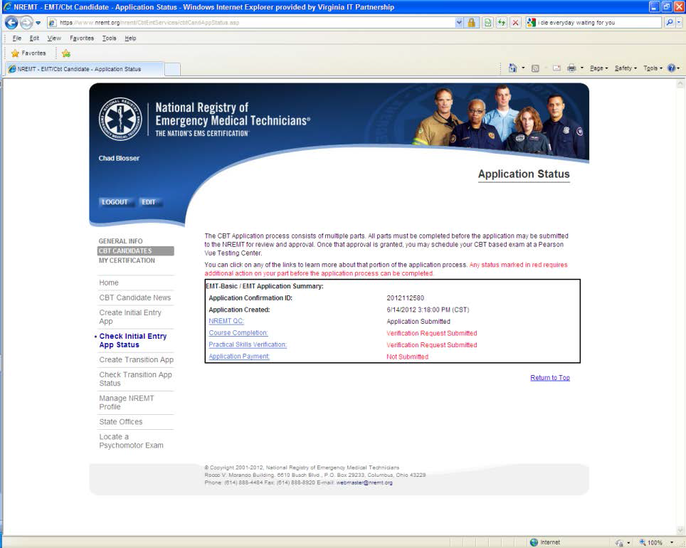
Track your application status
Step 9: Tracking your status

Slide 24
Track your application status
The application process for NREMT testing involves multiple parts:
NREMT will tract your application steps and issue your National Registry Authorization to Test (ATT) letter – when applicable
Your teaching agency will verify your successful course completion. Under 18 y/o by MIEMSS
MIEMSS will verify your successful practical (psychomotor) exam completion

Slide 25
Need Help ?
You can contact your instructor/teaching agency
You can contact NREMT
nremt.org
(614) 888-4484
You can contact MIEMSS Office of Licensure & Certification
410-706-3666 or 800-762-7157

Slide 26
Additional information
Payment – If you are affiliated with a Maryland EMS program your testing fee for the practical (psychomotor) and first cognitive attempt are covered.
If not affiliated, you will need to pay:
MIEMSS $60 for the EMT practical
NREMT for the cognitive
EMR $65
EMT $70

Slide 27
Thank You
for your interest in
Maryland EMS!

